Slide 1
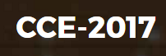





Catalytic degradation of Natural Organic Matter (NOM) by Advanced Oxidation Technologies
Ana María García^{1,*}, Ricardo A. Torres-Palma², Miguel-Ángel Vicente³, Antonio Gil⁴ and Luis-Alejandro Galeano^{1,*}
¹ Research Group on Functional Materials and Catalysis (GIMFC), Nariño University, Department of Chemistry, Colombia
² Research Group on Environmental Remediation and Biocatalysis, Antioquia University, Colombia
³ Salamanca University Department of Inorganic Chemistry, Spain
⁴ Public University of Navarre, Campus Arrosadía, Spain
(*) Presenting Author’s E-mail: ana.garcia11@udea.edu.co
(*) Corresponding Author´s E-mail: alejandrogaleano@udenar.edu.co

Slide 2
INTRODUCTION

Slide 3
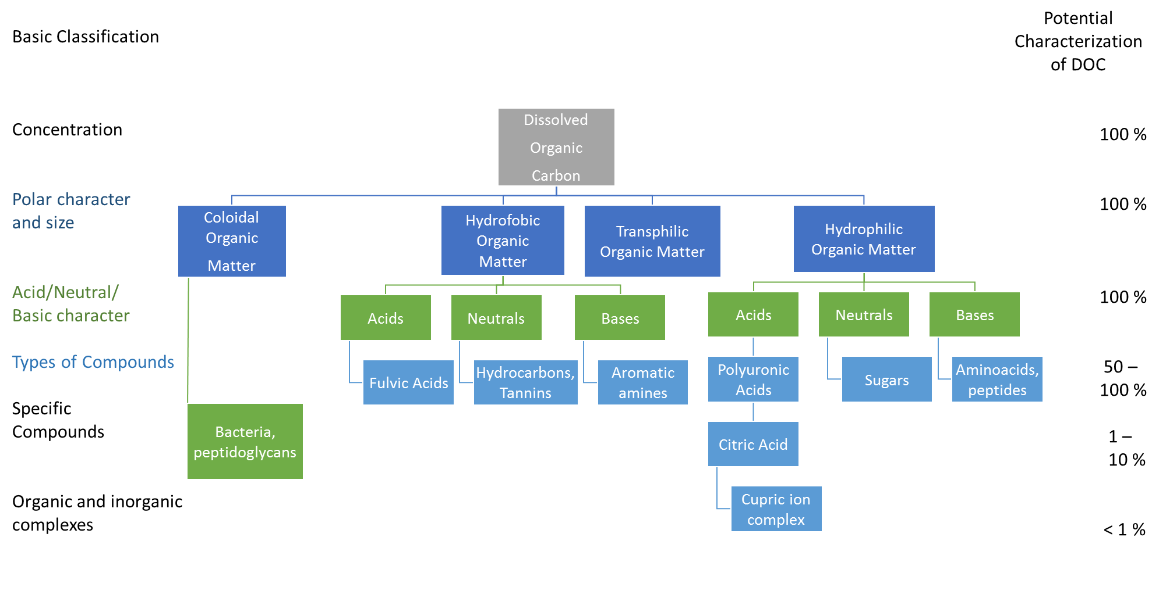

NOM composition
$$≈50 \%$$
Humic acids (HA)
Fulvic acids (FA)
humins
3
Leenheer et al. (2003). Sci. Technol. 37, 18A–26A.

Slide 4
NOM composition
Property | HA | FA
Elemental composition (Weight %)
Carbon | 50–60 | 40–50
Hydrogen | 4–6 | 4–6
Oxygen | 30–35 | 44–50
Nitrogen | 2–4 | <1–3
Sulfur | 1–2 | 0–2
Solubility below pH 2.0 | Not soluble | Soluble
Apparent molecular weight range (atomic mass units) | Few hundreds to several millions | 180–10,000
Functional group distribution
Carboxyl (–COOH) | 14–45 | 58–65
Phenol (–Ph) | 10–38 | 9–19
Alcohol (–R–OH) | 13–15 | 11–16
Carbonyl (–C=O) | 4–23 | 4–11
Methoxyl (–O–CH₃) | 1–5 | 1–2
Chemical composition and molecular size
Functional groups, including esteric, phenolic, quinine, carboxylic, hydroxyl, amino, and nitroso compounds.
Molecular weight
From several hundreds to tens of thousands (Humic substances).
Structure
Substituted aromatic rings linked to aliphatic chains.
4
Matilainen et al. (2011). Chemosphere 83, 1431–1442.

Slide 5
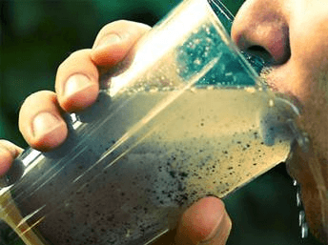
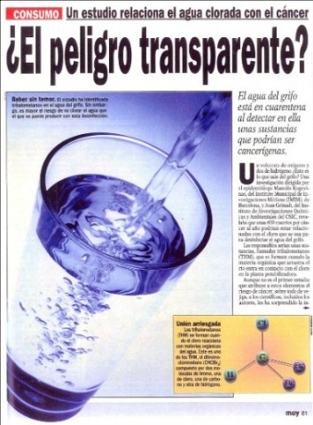

Some other aspects to take into account….
Cl₂
NOM
$≈$ 700 DBPs
color
taste
odor
DBPs
Saturation of activated carbon
Fouling of membranes
Substrate for bacterial growth
Trihalomethanes
THMs
Haloacetic acids
HAAs
5
Gough et al. (2014). Sci. Total Environ. 468–469, 228–239.

Slide 6
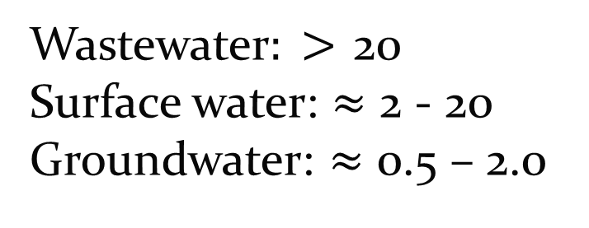
Typical NOM concentrations in real water sources
TOC (mg/L)
Effluent of wastewater treatment plant
Effluent of aeration followed by activated sludge
Wastewater$: >$ 20
Surface water: $≈$ 2 - 20
Groundwater: $≈$ 0.5 – 2.0
HPI: Hydrophilic fraction
HPO: Hydrophobic fraction
TPI: Transphilic fraction
Secondary effluent from a water regeneration plant
Effluent of pre-treatment with activated sludge, coagulation and sand filtration
Gong et al. (2008). Water Res. 42, 1238-1244.
Jarusutthirak et al. (2002). Desalination 145, 247-255..
Hu et al. (2003). Water Res. 37, 4801-4809.
Zhang et al. (2009) J. Hazard. Mater. 164, 1433-1438
6

Slide 7
Typical treatment stages at drinking water facilities
Corrosion Control
Fluoride
Dist.
Sys.
Coagulant
Disinfectant
Clear
well
raw water
rapid
mix
flocculation
Settling
Filtration
Remove some of the NOM & suspended particles
Kills or inactivates pathogenic organisms
7

Slide 8
AOTs
CWPO
Fe,Cu-catalysts
H₂O₂/Fe²⁺ (Fenton)
TiO₂/hν/O₂ Photocatalytic
H₂O₂/Fe³⁺ (Fenton - like)
H₂O₂/Fe²⁺ (Fe³⁺) /UV (Photoassisted Fenton)
Mn²⁺/Oxalic acid/O₃
HO•
H₂O₂/Fe³⁺- oxalate
H₂O₂/UV
O₃/UV
O₃/H₂O₂
HO. Eº = 2,80
GOAL
MINERALIZATION
CO₂ + H₂O and by-products
NOM
+ H₂O₂
8

Slide 9
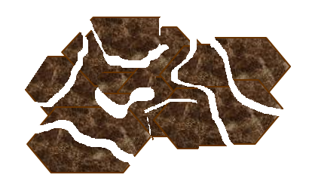

2. AOTs FOR NOM DEGRADATION
O H
O H
O H
O H
O H

Slide 10
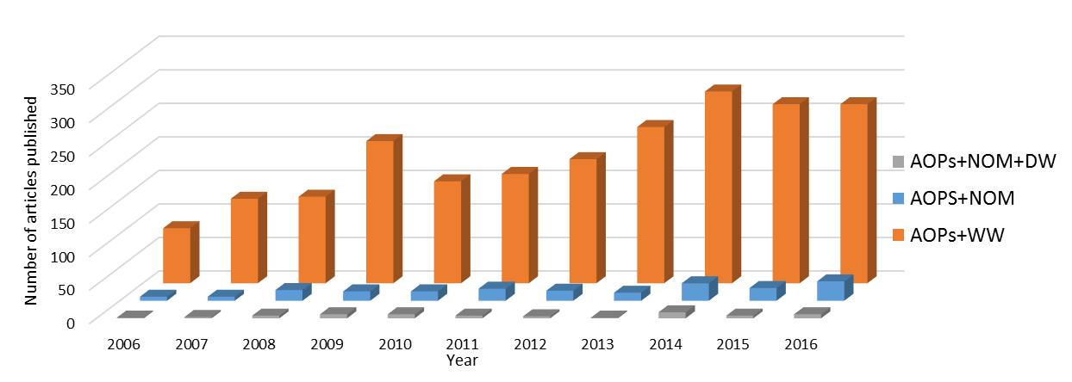
Global interest in AOTs for catalytic degradation of NOM in the past few years
AOTs+NOM+DW
AOTs+NOM
AOTs+WW
Figure 1. Number of publications in indexed journals containing the following keywords: NOM: natural organic matter; AOPs: advanced process oxidation; DW: drinking water; WW: wastewater in abstract through 2006 to 2016.
10
Source: Scopus, October 30, 2016.

Slide 11
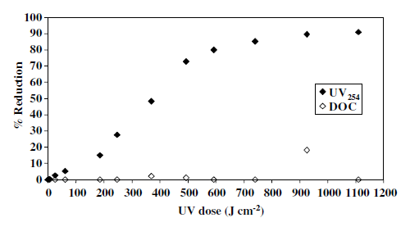
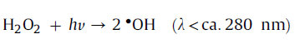
UV-light based degradation
Target compound
NOM
Matrix
Raw water, [DOC]₀ = 17.4 mg/L, UV₂₅₄=53.58 m⁻¹, pH: 4.54
AOT features
UV lamp at 254 nm
Recorded parameters
DOC, UV₂₅₄, HP-SEC
Figure 2. Treatment of reservoir water by UV-C photolysis (initial
DOC = 17.4 mg L⁻¹, initial UV₂₅₄ = 53.58 m⁻¹).
UVC < UV/H₂O₂
11
Goslan et al. (2006). Chemosphere 65, 1113–1119.

Slide 12
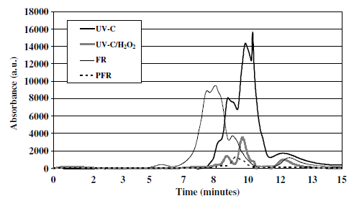
UV-light based degradation
Figure 3. HP-SEC molecular size distribution of reservoir water treated at optimum reaction conditions for each process
Figure 2. Treatment of reservoir water by UV-C photolysis (initial
DOC = 17.4 mg L⁻¹, initial UV₂₅₄ = 53.58 m⁻¹).
UVC < UVC/H₂O₂
12
Goslan et al. (2006). Chemosphere 65, 1113–1119.

Slide 13
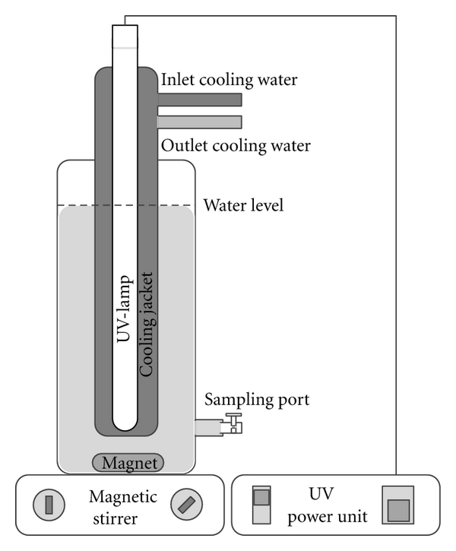
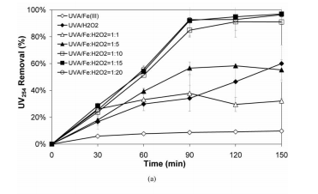

Fenton processes: photo-Fenton
Target compound
HA
Matrix
Synthetic HA solution (Fluka
HA)
AOT features
Fenton reagent/UVA with máximum centered at 365 nm
Recorded parameters
DOC, UV₂₅₄, HP-SEC, LCC
fractionation
UVA/Fe³⁺:H₂O₂(1:15)
UVA/H₂O₂
UVA/Fe³⁺:H₂O₂(1:5)
UVA/Fe³⁺:H₂O₂(1:1)
UVA/Fe³⁺
Figure 4. Removal of UV₂₅₄ at different H₂O₂ to Fe³⁺ molar ratios
$$Fe\left(III\right)−Fe(II)$$
13
Sanly et al. (2007). Sep. Sci. Technol. 42, 1391–1404.

Slide 14
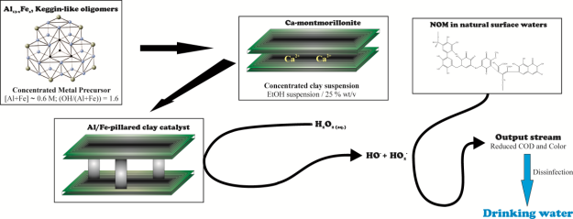


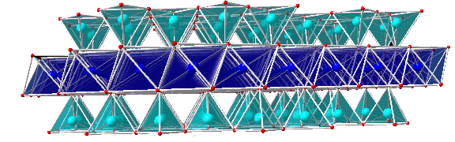
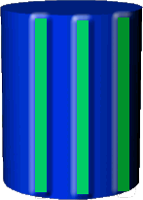
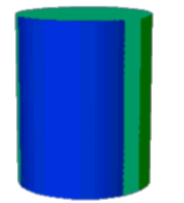
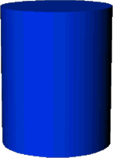
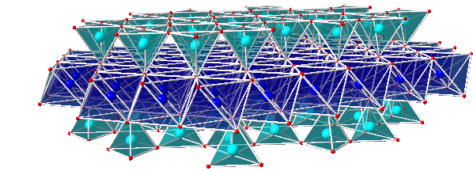
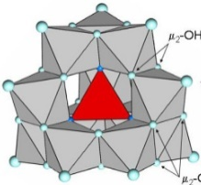
Fenton heterogeneous processes: Al/Fe-PILC activated
Catalytic Wet Peroxide Oxidation (CWPO)
14
Galeano et al. (2012). Appl. Catal. B: Environ. 111-112, 527-535.

Slide 15
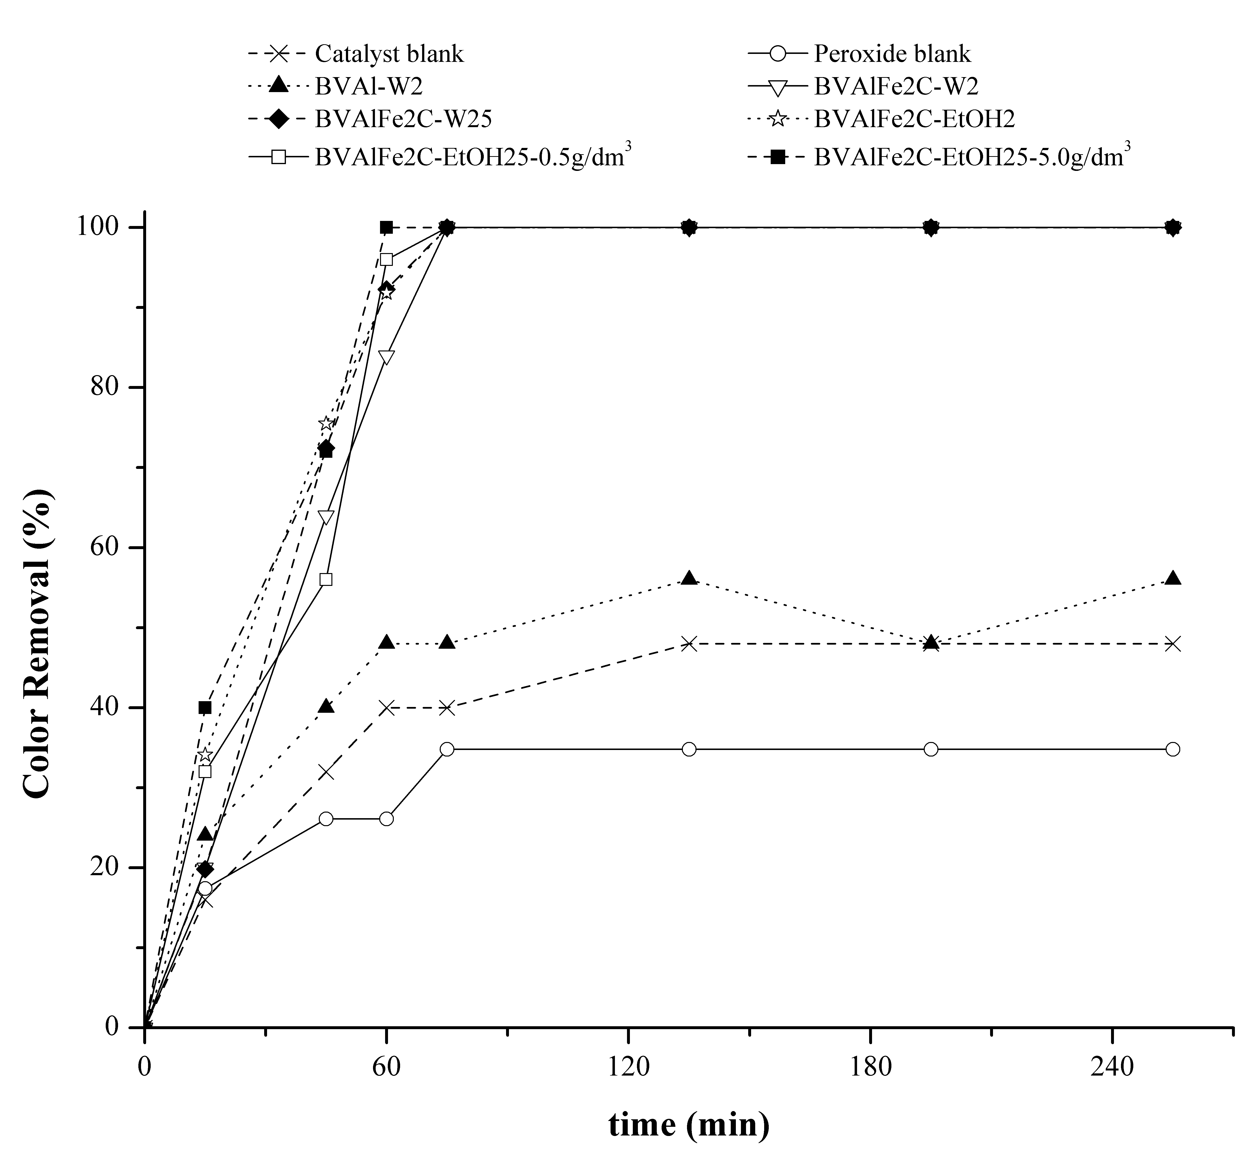
Catalytic Wet Peroxide Oxidation (CWPO): color removal
Target compound
NOM
Matrix
Surface water, [COD]₀ = 40.14 mg O₂/dm³
[Color₄₅₅]₀ = 42 PCU
AOP features
[Catalyst] = 0.5 g/dm³
[H₂O₂]_{ad.} = 0.047 mol/dm³
H₂O₂ veloc. = 6.0 cm³/h
[H₂O₂]/[COD]₀ = 1.0
pH = 3.7
T = 291 ± 2.0 K
P = 72 kPa
Recorded parameters
COD, Color removal
[Fe]_{leach.} ≤ 0.5 mg/dm³
Figure 5. Color455 removals from raw surface water displayed by the clay catalysts.
PCU: Pt-Co units
15
Galeano et al. (2012). Appl. Catal. B: Environ. 111-112, 527-535.

Slide 16
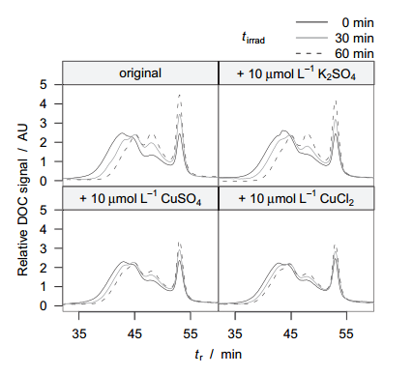
Photocatalysis
Target compound
NOM
Matrix
Surface water, [DOC]₀ = 2 mg/L, UV₂₅₄=0.081 cm⁻¹, pH: 6.5
AOT features
Degussa Cu/TiO₂
Recorded parameters
SEC, DOC
CB
Photon
Band gap
VB
Figure 6. Control experiments for the inhibiting effect of added Cu²⁺.
16
Espinoza et al. (2011). Water Res. 45, 1039–1048.

Slide 17
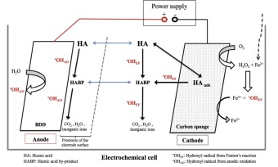
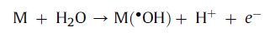


Electro-Fenton (EF) and anodic oxidation (AO)
Target compound
HA
Matrix
Surface water, , TOC₀=16.2 mg/L
AOT features
Anode: Pt or BDD, Cathode: CS o SS, pH 3.0, EF: 0.1 mM Fe²⁺
Recorded parameters
TOC_{tot}= TOC_{sol} + TOC_{ads}
UV-vis
ICP-OES: [Fe]
Figura 7. Scheme of removal of humic acids from drinking water by anodic oxidation and electro-Fenton processes.
17
Trellú et al. (2016). Appl. Catal. B: Environ. 194, 32-41

Slide 18
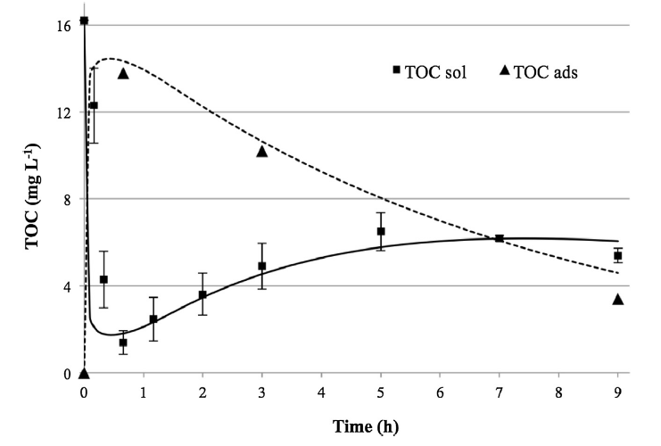
Electro-Fenton (EF) and anodic oxidation (AO)
EF-Pt
85 %
Target compound
HA
Matrix
Surface water, , TOC₀=16.2 mg/L
AOT features
Anode: Pt or BDD, Cathode: CS, pH 3.0, EF: 0.1 mM Fe²⁺
Recorded parameters
TOC_{tot}= TOC_{sol} + TOC_{ads}
UV-vis
ICP-OES: [Fe]
40 min, Promotes sorption: complexation HAs + Fe
38 %
Figure 8. Evolution of TOCsol and TOCads during the electrolysis of HAs solution (TOC₀= 16.2 mg L⁻¹) by EF-Pt process at 300 mA (0.05 M Na₂SO₄; 0.1 mM Fe²⁺). Symbols report experimental results. Error bars refer to triplicate experiments. Lines report model results.
18
Trellú et al. (2016). Appl. Catal. B: Environ. 194, 32-41

Slide 19
THANK YOU

