Slide 1
Statistical optimization of the catalytic wet peroxide oxidation (CWPO) of phenol activated by Al/Fe-PILC clay catalyst
Luis Alejandro Galeano¹; Jessica Basante
¹ Grupo de Investigación en Materiales Funcionales y Catálisis (GIMFC) Departamento de Química, Universidad de Nariño. Pasto – Colombia.
E-mail: alejandrogaleano@udenar.edu.co

Slide 2
Introduction

Slide 3
Advanced Oxidation Processes (AOPs)
CWPO
Fe,Cu – solid catalysts
H₂O₂/Fe²⁺ (Fenton)
TiO₂/hν/O₂ Photo -catalytic
H₂O₂/Fe³⁺ (Fenton - like)
Mn²⁺/Oxalic acid/O₃
HO·
H₂O₂/Fe²⁺ (Fe³⁺)/UV (Photo-assisted Fenton)
H₂O₂/Fe³⁺- oxalate
H₂O₂/UV
O₃/UV
O₃/H₂O₂

Slide 4
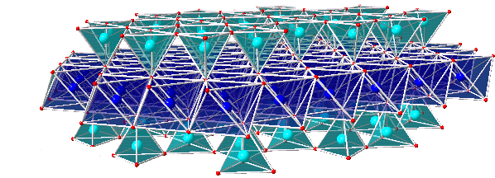
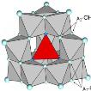
Al/Fe Pillared clays (Al/Fe-PILCs) useful catalyzing CWPO
Cluster Al_{x}O_{y}
Cluster Fe_{x}O_{y}
Mixed Al/Fe pillar
Al₂O₃ Pillar
S_{BET}
d₀₀₁
T stability
Accesibility
Catalytic performance
Fe decorating
Al₂O₃ pillar
Galeano, L. A.; Gil, A.; Vicente, M. A. Appl. Catal. B-Environ. 100 (1) (2010) 271-281.
Notes:
Arcillas porqué? Accesibilidad, bajo costo
Refinación previa encarece el proceso!
Propiedades microporosas.

Slide 5
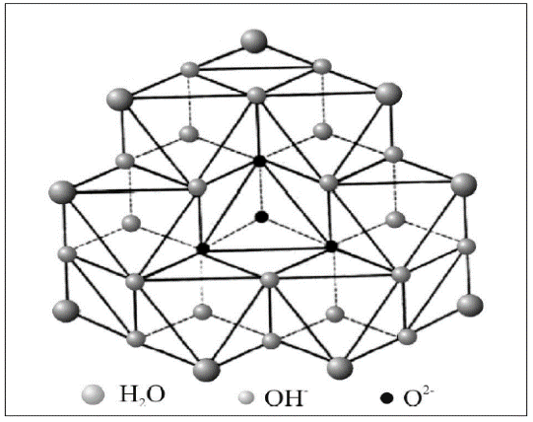
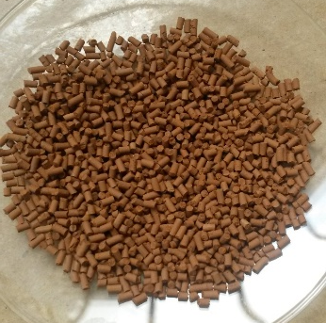
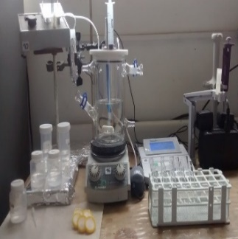
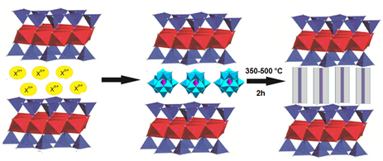
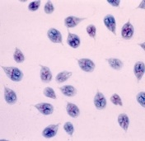
CWPO – Drinking Water
Scaling-up
Al/Fe-PILC
Efficient CWPO active catalyst
[Al(Al₁₂O₄(OH)₂₄(OH₂)₁₂]⁷⁺
d₀₀₁
Intensification process
Al/Fe-PILC
Drinking Water
CWPO
Fe uptake!
Catalyst shaping
Extrudates
Microspheres
Catalytic potential
MO; PhO; NOM
Highly concentrated Interlayering Al/Fe mixed hydrolyzed precursor
Simpler and efficient clay Interlayering method

Slide 6
Factors affecting catalytic performance in CWPO reaction
CWPO
[subst.]
pH
Catal. nature
[Catal.]
[H₂O₂]
T
P
Etc….
[PhO]
pH
[Catal]
[H₂O₂]

Slide 7
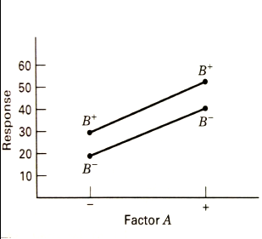
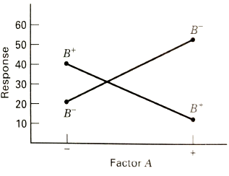
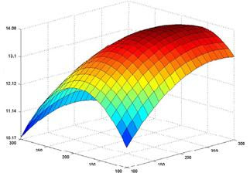
One factor at a time….
DOE/RSM
Statistically significant results
Minimum number of experiments
Montgomery D.C., (2005). Design and Analysis of Experiments, 6^{th.} ed., John Wiley & Sons, Inc.

Slide 8
Experimental

Slide 9
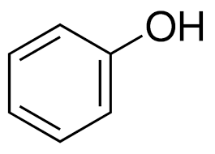
Experimental design for optimization of the main operating parameters in the CWPO degradation of phenol (PhO) under variable physicochemical characteristics
0.62 % Fe_{active}
GOALS:
Minimum TOC
máximum PhO degradation.
maximum fraction of H₂O₂ reacted
[Al/Fe-PILC]
Number of runs: 10
Experimental factors: 2
Central Composite Factorial 2²
experimental design
Hydrogen Peroxide dose (%):
55.0 – 75.0
Catalyst concentration
(g/L): 1.5 - 4.0
Responses: 3
Number of blocks: 1
Non-controlable variables
pH₀
6.0 – 9.0
[H₂O₂]_{r} (%) (Spectrophotometric)
PhO mineralization TOC removal (%)
Starting PhO concentration [PhO]₀
TOC (mg C/L): 2.0 – 20.0
PhO Removal (%) - HPLC
Semi-batch reactor
Reaction time: 180 min
Temperature of reaction (T_{r}) (°C): 5.0 – 25.0

Slide 10
Results

Slide 11
Matrix of experiments
Exp | Factors |  | Responses |  |  | Co-variables |  |  | [Fe_{act.}]/[H₂O₂]
 | H₂O₂ dosing (Stoic. %) | [CAT] (g/L) | TOC removal (%/g cat.) | H₂O₂ React. (%/g Cat.)^{d} | PhO_{degr.} (%/g Cat.) | pH₀ | TOC₀ (mg/L) | T (°C)
1 | 65.0 (50.6) | 2.750 | 11.923 | 14.962 | 11.359 | 7.2 | 12.0 (15.4) | 22.6 | 0.070
2 | 72.1 (68.7) | 3.634 | 8.120 | 17.548 | 9.373 | 8.9 | 7.7 (8.0) | 12.3 | 0.131
3 | 75.0 (62.7) | 2.750 | 11.722 | 20.295 | 15.834 | 6.7 | 10.7 (12.8) | 6.1 | 0.068
4 | 72.1 (64.7) | 1.866 | 15.335 | 33.255 | 23.362 | 7.2 | 9.0 (10.0) | 10.0 | 0.057
5 | 55.0 (52.9) | 2.750 | 18.960 | 37.204 | 14.776 | 7.5 | 11.5 (12.0) | 15.1 | 0.086
6 | 57.9 (58.0) | 1.866 | 27.759 | 41.713 | 24.759 | 6.7 | 14.6 (14.6) | 21.0 | 0.044
7 | 65.0 (59.1) | 4.000 | 14.935 | 12.969 | 10.903 | 7.1 | 18.6 (20.4) | 25.6 | 0.065
8 | 65.0 (60.2) | 2.750 | 11.983 | 18.211 | 14.023 | 7.0 | 5.8 (6.3) | 17.6 | 0.144
9 | 65.0 (61.0) | 1.500 | 27.045 | 46.668 | 24.899 | 7.0 | 14.9 (15.9) | 23.3 | 0.031
10 | 57.9 (53.6) | 3.634 | 11.219 | 16.165 | 10.021 | 6.9 | 10.5 (11.4) | 19.2 | 0.118

Slide 12
Statistical significance of every response
PhO _{degr.}
TOC _{removal}
H₂O_{2 reacted}

Slide 13
Single-response surfaces
Response | Optimal value (%/g cat.) | Factor
 |  | H₂O₂ dosing (Stoic. %) | [CAT] (g/L)
PhO_{degr.} | 29.4 | 75.0 | 1.5
TOC removal | 36,4 | 55.0 | 1.5
H₂O_{2 React.} | 65,7 | 55.0 | 1.5

Slide 14
Combined, multi-response surface in semi-batch reactor
Response | Optimal value (%/g cat.) | Factor
 |  | H₂O₂ dosing (Stoic. %) | [CAT] (g/L)
PhO_{degr.} | 19.8 | 62.0 | 1.5
TOC removal | 30.0
H₂O_{2 React.} | 26.9

Slide 15
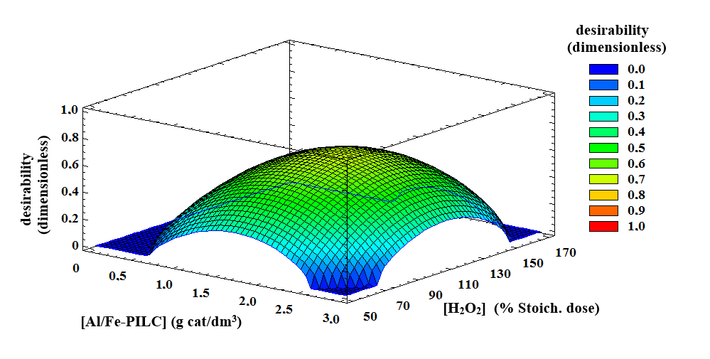
Combined, multi-response surface in slurry continuous reactor
Optimized multiple-response surface (desirability function: maximized [TOC]_{r} and [PDL]_{r} and minimized [H₂O₂]_{r}) of the CWHPO degradation of phenol by Al/Fe-PILC catalyst in continuous slurry reactor
Ramírez, J.H.; Galeano L.A. et al. J. Environ. Chem. Eng. (2017) submitted.

Slide 16
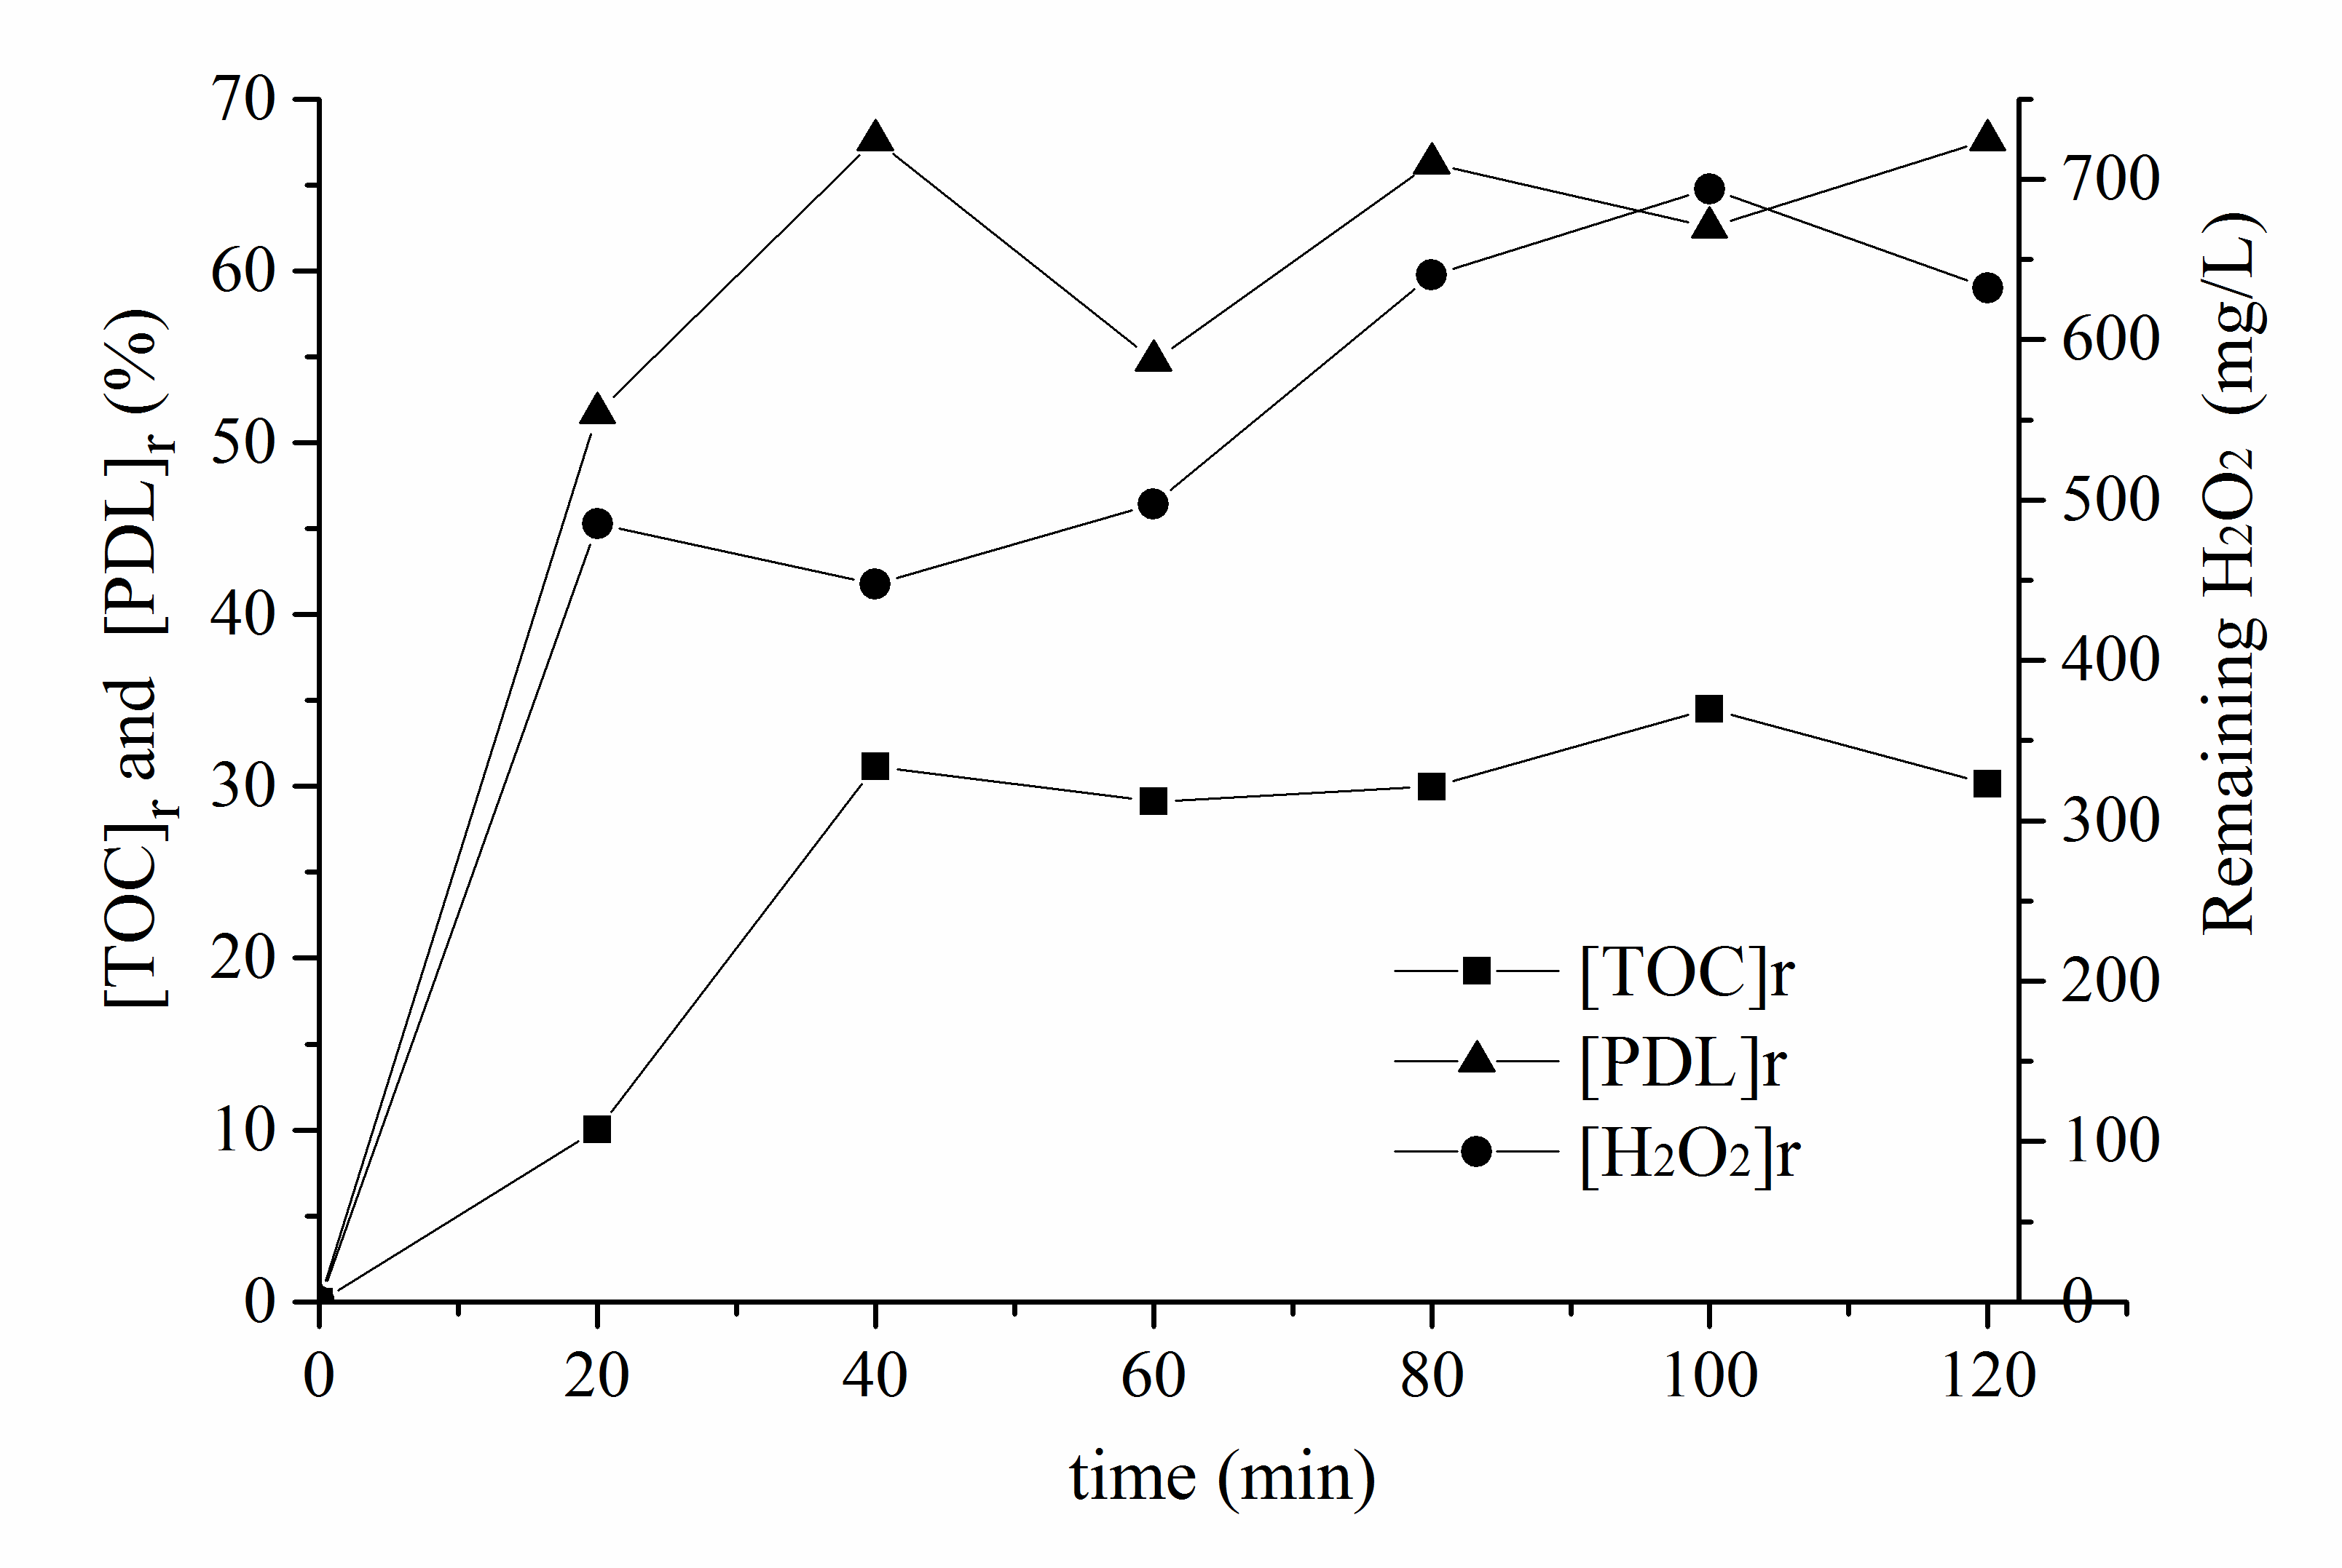
Optimal conditions translated to continuous slurry reactor
Reaction volume 1.3 dm³; T = 18.0 +/- 1.0 °C; atmospheric pressure = 76 kPa; pH = 7.0; stirring rate 600 rpm; Q_{phenol} = 8.0 mL/min; [Phenol]_{in} = 0.276 mmol/L ([TOC]_{in} = 20 mg C/L); Q_{H2O2} = 1.6 mL/min; [H₂O₂]_{in} = 20.91 mmol/L; [Al/Fe-PILC] = 1.77 g/L and residence time = 135 minutes.
Ramírez, J.H.; Galeano L.A. et al. J. Environ. Chem. Eng. (2017) submitted.

Slide 17
Concluding Remarks
Statistical RSM is useful tool optimizing heterogeneous Fenton degradation of contaminants in water samples displaying varied physicochemical characteristics.
Optimal CWPO degradation of phenol under circumneutral pH conditions decreases significantly either, the top pollutant’s degradation, TOC removal and use of hydrogen peroxide respect to performance at pH values < 4.0.
Use of responses defined per gram of catalyst enabled successful optimización in semi-batch reactor (adsorption disregarded).

