Slide 1
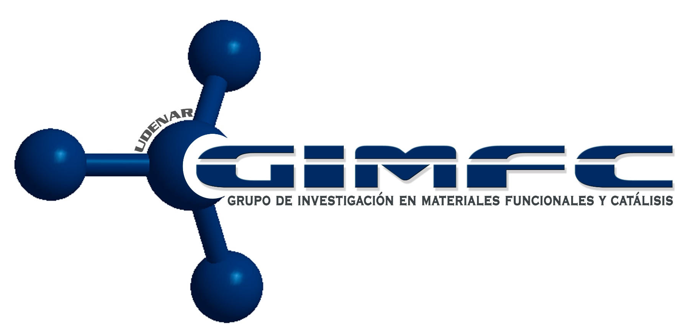

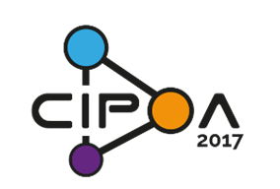
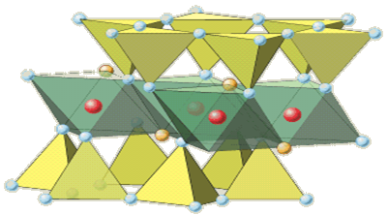
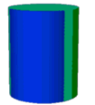
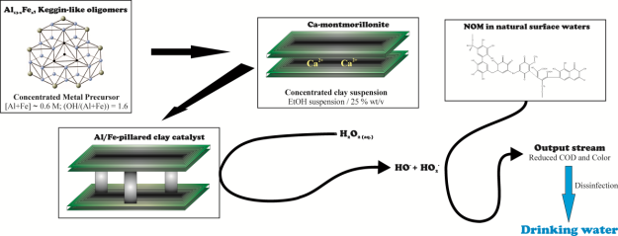
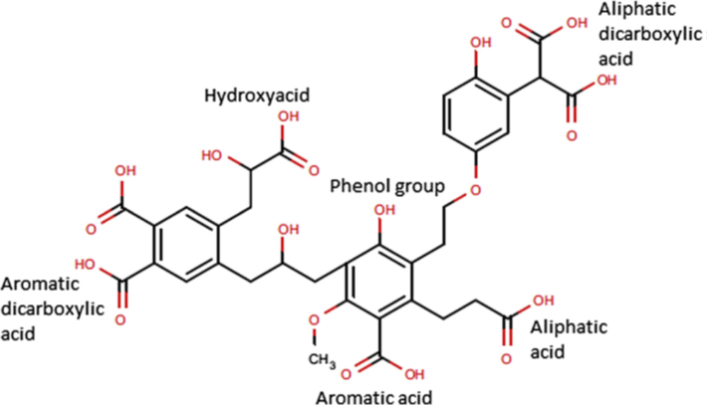
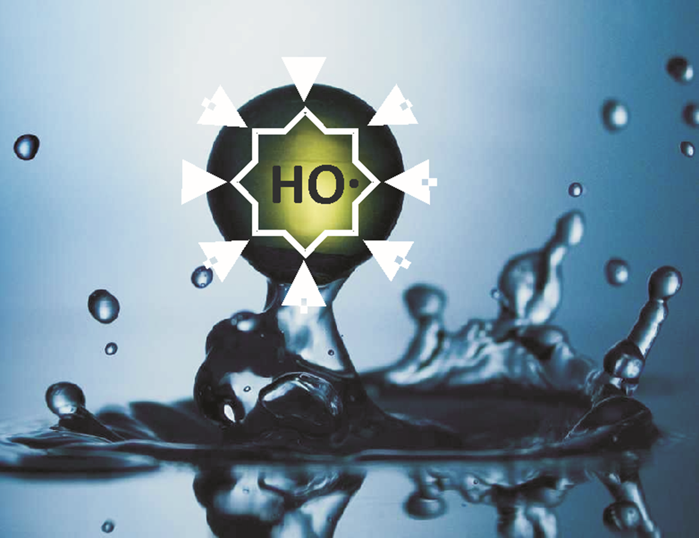
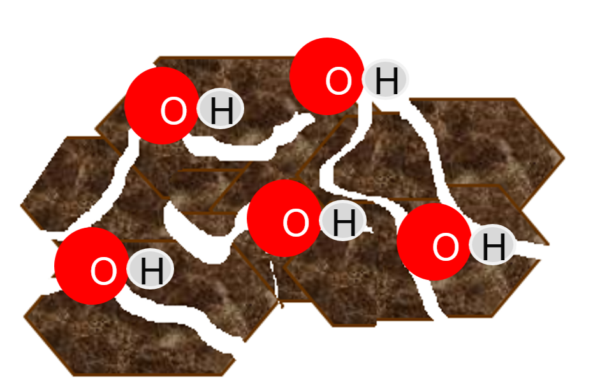
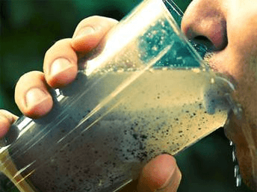
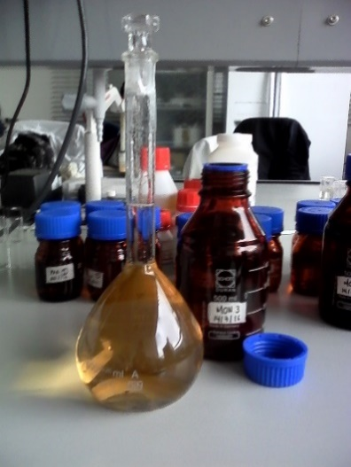
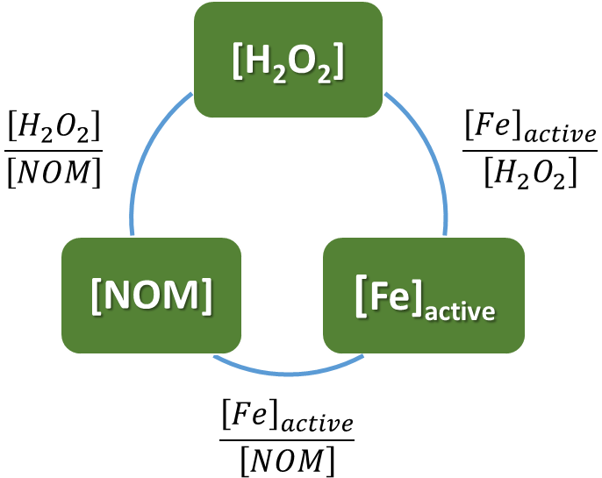
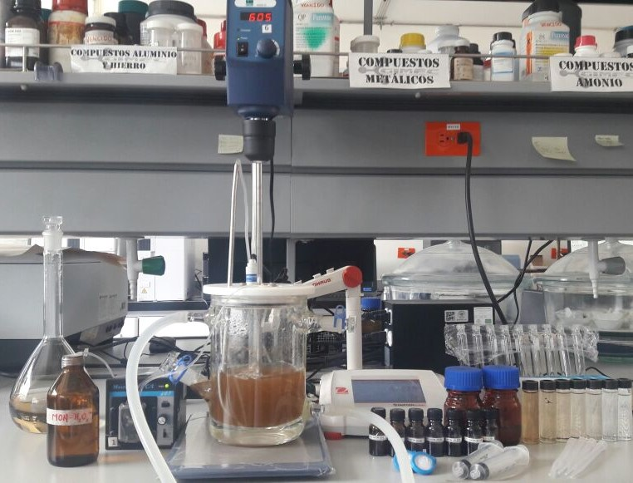
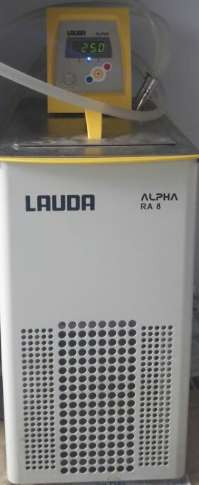
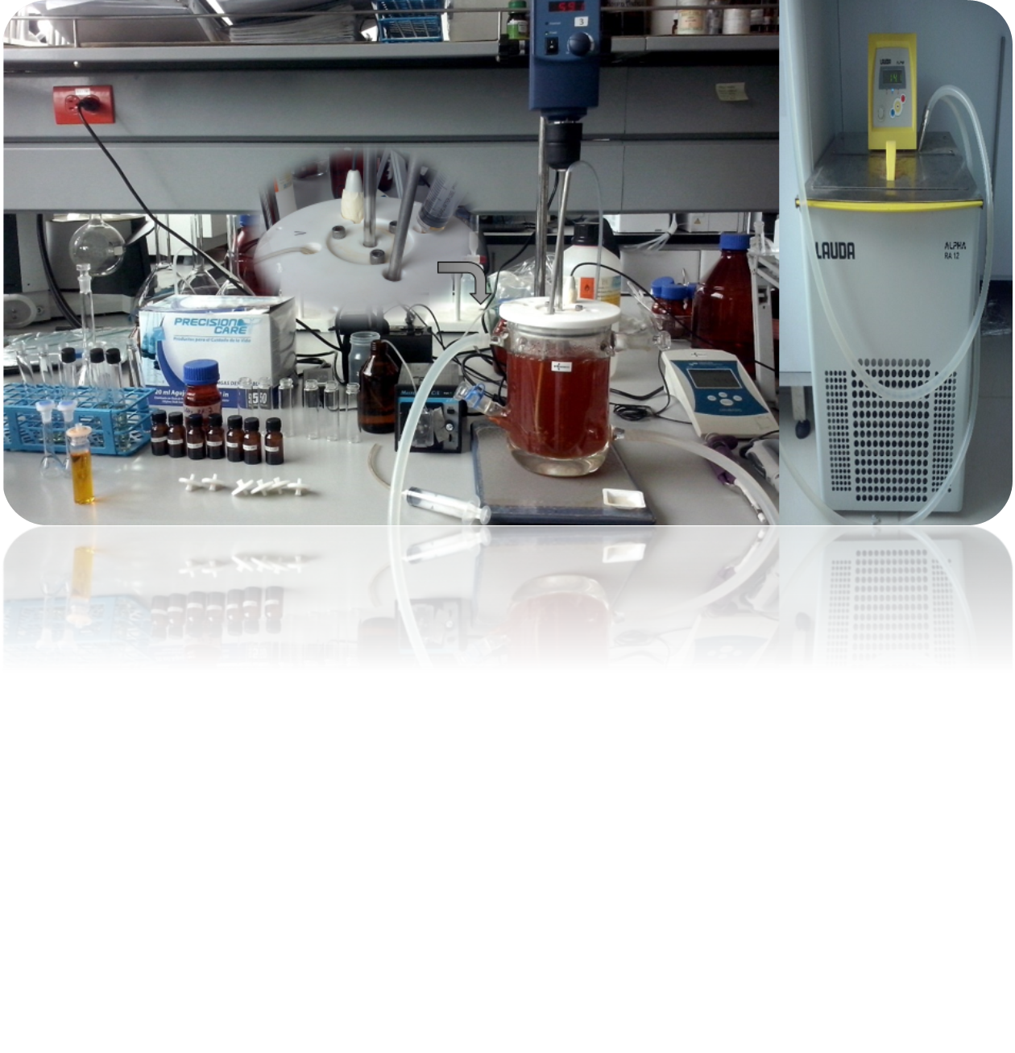
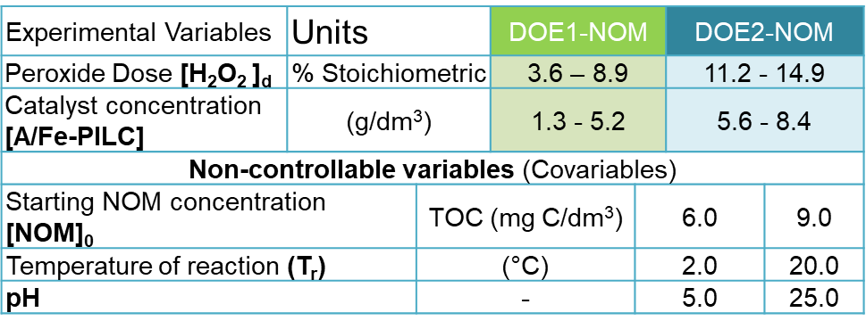
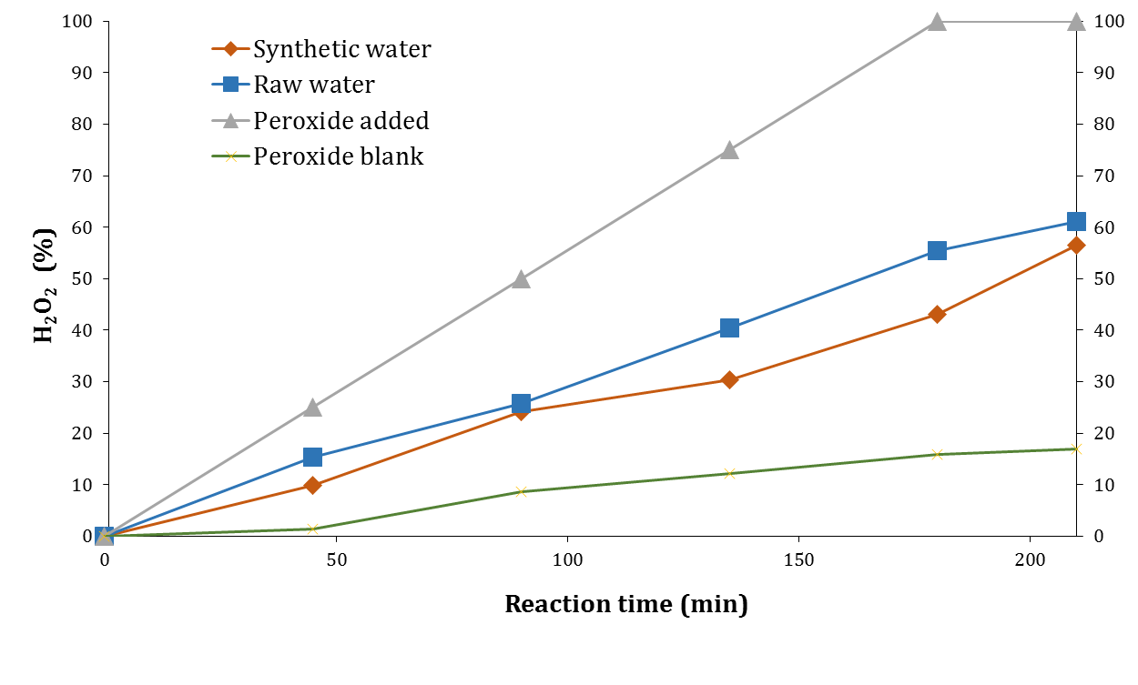
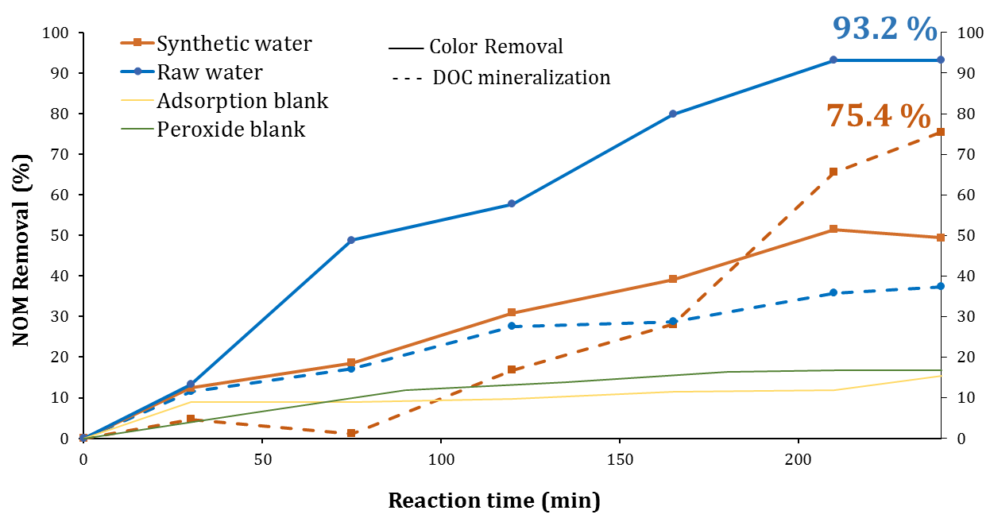
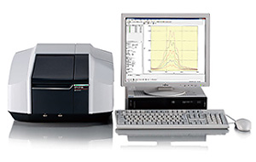
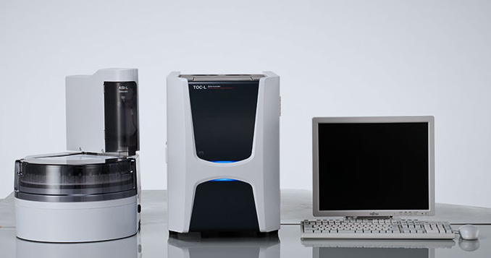

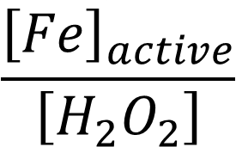
3rd Iberoamerican Conference on Advanced Oxidation Technologies (III CIPOA)
2nd Colombian Conference on Advanced Oxidation Processes (II Ccpaox)
November 14 – 17, 2017
Medellín (Guatapé), Colombia
RSM optimization of natural organic matter degradation by Catalytic Wet Peroxide Oxidation
A.M. Garcia-Mora^{1,2}, R. Torres-Palma², L.A.Galeano¹.
(1) Grupo de Investigación en Materiales Funcionales y Catálisis, Departamento de Química, Universidad de Nariño, Calle 18, Cra 50 Campus Torobajo, Pasto, Colombia, Email: anamariagarcia@udenar.edu.co; ana.garcia11@udea.edu.co
(2) Grupo de Investigación en Remediación Ambiental y Biocatálisis, Instituto de Química, Facultad de Ciencias Exactas y Naturales, Universidad de Antioquia UdeA, Calle 70 No. 52-21, Medellín, Colombia.
NOM decolourization
(%) (Spectrophotometric)
H₂O₂ reacted: [H₂O₂]_{r} (%) (Spectrophotometric)
NOM mineralization TOC removal (%)
Introduction
H₂O_{2(aq)}
Results
CWPO
Fe,Cu-catalysts
Mixed pillar Al/Fe
Optimization
Optimal response
Desirability: NOM decolourization + [H₂O₂ ]_{r} + NOM mineralization
Goal: maximize all responses
H₂O₂/Fe³⁺
(Fenton - like)
DOE1-NOM
Al/Fe-pillared clay catalyst
HO•+HO₂•
TOC removal
B: [Al/Fe-PILC]
–NOM_{ads}
A: [H₂O₂]_{d}
TOC removal
Fig. 7 Pareto’s diagram for TOC removal.
–NOM
[H₂O₂]_{d} (%)
[Al/Fe-PILC] (g/dm³)
Optimized desirability = 0.97
[Al/Fe-PILC]optimal = 6.01 g/dm³
[H₂O₂]_{d} optimal = 7.72 %
HO. Eº = 2.80 V
Fig. 6 Response surface for NOM mineralization (TOC removal).
NOM-mineral
interface
NOM: Natural organic matter
CWPO: Catalytic wet peroxide oxidation
Desirability
Methodology
Desirability
DOE2-NOM
Table 1. Preparation of synthetic NOM surrogate based on standards of different polarity.
[H₂O₂]_{d} (%)
[Al/Fe-PILC] (g/dm³)
Reagent¹ |  | NOM-fraction modelled² | Molecular weight (Da) | Abundance in synthetic water (TOC %)
Polyacrylic acid (PAA) |  | TPI | 130.000 | 20
Polystyrene sulfonate (PSS) | PSS-1 | HPO | 1´000.000 | 12.5
 | PSS-2 | HPO | 200.000 | 12.5
Polygalacturonic acid (PGUA) |  | HPI | 25.000-50.000 | 30
Humic acids (HA) |  | HPO | - | 25
Fig. 8 Multivariate Response surface – Desirability DOE1-NOM.
Desirability
Optimized desirability = 0.85
[Al/Fe-PILC]optimal = 6.0 g/dm³
[H₂O₂]_{d} optimal = 13.1 %
Desirability
¹All reagents Sigma-Aldrich used as received
²HPI: hydrophilic; TPI: transphilic; HPO: hydrophobic
Fig. 1 Preparation of synthetic water
Fig. 2 Relationships between three most influencing CWPO factors.
$$\frac{{\left[Fe\right]}_{active}}{\left[H_{2}O_{2}\right]}$$
2.432 mmol Fe/mmol H₂O₂ added
$$\left[NOM\right]:10 mg/{dm}^{3} TOC$$
[H₂O₂]_{d} (%)
[Al/Fe-PILC] (g/dm³)
Type of design | 2³
Optimization type | Central Composite
Number of runs | 10
Fig. 9 Multivariate Response surface – Desirability DOE2-NOM.
zoom
B: [Al/Fe-PILC]
B: [Al/Fe-PILC]
Table 2. First and second experimental designs (DOEs) used to optimize main operating parameters of CWPO.
Mechanical stirring
A: [H₂O₂]_{d}
[Al/Fe-PILC]
p-value: 0.0184
A: [H₂O₂]_{d}
H₂O₂ Dose
p-value: 0.0375
air bubbling
pH control
T control
Fig. 10 Pareto’s diagram for H₂O₂ reacted.
Fig. 11 Pareto’s diagram for NOM removal.
Synthetic water
H₂O₂
sampling
H₂O₂
NOM
+
C₂-Exp-PILC
% Stoichiometric dose: 7.08 mg H₂O₂/mg COT [1]
T control
Sample
Analytical methods
Fig. 3 Real laboratory set-up for CWPO-degradation of NOM. Experimental parameters: Peroxide Dose [H₂O₂]_{d}= 13.1 % stoichiometric (SW: 87 mg/L, RW: 50 mg/L); Catalyst concentration [Al/Fe-PILC]*: 6.0 g/dm³; pH_{SW} 7.0 and pH_{RW} 7.3; Temperature_{SW}: 25 °C and Temperature_{RW}: 14 °C (RT on sampling); full reaction time: 180 min; full recorded time: 240 min.
Fig. 12 CWPO degradation of NOM: organic color removed at 456 nm (2120C-Standard Methods) and DOC mineralization (TOC-L Analyzer Shimadzu) to Synthetic and raw water*.
Fig. 13 Fraction of hydrogen peroxide reacted vs. added through the CWPO catalytic tests.
Conclusions
* Raw water collected in Vereda Charandú surface source. Surrounding of Ipiales – Nariño, Colombia
Fig. 4 Spectrophotometer UV-2600
Fig. 5 Dissolved organic carbon.
The removal of natural organic matter from aqueous solutions using Catalytic Wet Peroxide Oxidation activated by Al/Fe-PILC catalyst was successfully optimized by using statistical tools. Optimal operating conditions at neutral starting pH were found to be: [H₂O₂]_{d} 13.1 %; [Al/Fe-PILC] 6.0 g/L within a range of starting TOC concentrations (0 – 20 mg C/L) and controlled temperatures (5.0 - 25 °C). Catalytic tests under optimal conditions achieved higher percentage of color removal (~ 93 %) on raw water than on synthetic water (~ 50 %); however, NOM mineralization was significantly higher (75 %) on synthetic water vs. real water (37 %), probably because of formation of more refractory hydrophilic substances along process on real water.
* Al/Fe-PILC: Atomic Metal Ratio AMR (Fe) = 3.17 %; Total Metal Concentration (TMC) = 5.73 mol/dm³; Interlayering solution: Auto-hydrolysis with starting ratio (Al³⁺/Al⁰) = 14/86 [2]; Final heating: 400 °C/2 h). Final Fe_{active} content: 0.62 wt. %.
Acknowledgment
Financial support from CWPO for enhanced Drinking Water Quality in Nariño Project (BPIN 2014000100020), CT&I Fund of the SGR – Colombia is gratefully acknowledged. AMG also thanks PhD Scholarship granted From Nariño Department Program (BPIN 2013000100092).
References
^{[1]} Deng Y., Englehardt J., Water Res. 40 (2006), 3683– 3694.
^{[2]} Akitt W. J, Farthing A., J. Chem. Soc., Dalton Trans. (1981), 1624-1628.
^{[3]} Galeano L.A., Bravo P.F., Luna C.D., Vicente M.A, Gil A., App. Catal. B 111–112 (2012), 527-535.

