Slide 1
Recent trends about the application of carbon dioxide in catalytic processes
Luis Alejandro GALEANO, Gabriel MORALES
Research Group on Functional Materials and Catalysis (GIMFC),
University of Nariño, Pasto – Colombia
alejandrogaleano@udenar.edu.co

Slide 2
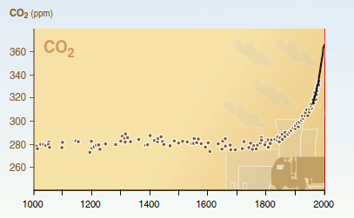
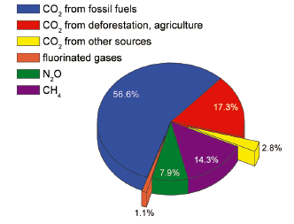
Climate change and CO₂ emissions
~ 390 ppm (in 2011)
(1)
Global greenhouse gas emission sources in 2004 (2)
≈77%
Industrial
Revolution
(1) H. Gitay, A. Suárez, R.T. Watson. Climate change and biodiversity. Intergovernmental Panel on Climate Change. 2002 p. 4
(2) K. Sumida, D. L. Rogow, J. A. Mason, T. M. McDonald, E. D. Bloch, Z. R. Herm, T.-H. Bae, J. R. Long. Chem. Rev. 112 (2012) 724.
Notes:
EMISSIONS
The concentration of CO2 in the atmosphere at the present time is greater than at any other time in modern history, exceeding 390 ppm in 2011.
Global CO2 emissions have increased by approximately 80% over the period 1970 - 2004 (from 21 to 38 Gt/year).
- The utilization of CO2 as an alternative source of carbon has several advantages, such as:
1. Alleviating global climate change caused in part by the increasing CO2 emissions;
2. Extending the present limited carbon resources (coal, petroleum and natural gas) into an environmentally friendly and easily obtainable carbon source, i.e. CO2; and
3. Simulating photosynthesis and enzyme-catalyzed reactions in the laboratory would be helpful in understanding the photosynthetic process in Nature and in
utilizing enzyme-analogous reactions for chemical syntheses.

Slide 3
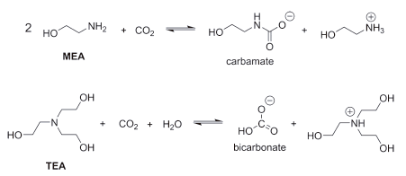
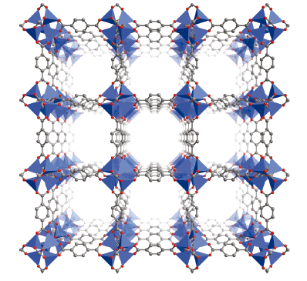
Chemical methods
Physical methods
MOF-5 : Zn₄O(BDC)₃
CO₂ emissions
CO₂ capture
CO₂ storage
Industrial uses
Raw material
Products
Process
Fuels
(carbon, gas, biomass)
(3) K. Sumida, D. L. Rogow, J. A. Mason, T. M. McDonald, E. D. Bloch, Z. R. Herm, T.-H. Bae, J. R. Long. Chem. Rev. 112 (2012) 724.
Notes:
IMPORTANCE OF CAPTURE
The discovery of new materials exhibiting the right properties for performing CO2 capture is an area requiring urgent development.
The most significant challenge for CO2 capture at present is the large energy penalty associated with the capture process.
The high cost primarily arises from the large energy input required for regeneration of the capture material.
Aqueous alkanolamine solutions carries an energy penalty of roughly 30% of the output of power plants.
Metalorganic frameworks are a new class of materials that could serve as an ideal platform for the development of next-generation CO2 capture materials. Three main scenarios for CO2 capture from power plants: (1. post-combustion capture); (2. pre-combustion capture) and (3. oxy-fuel combustion).
URGENT NEEDS
In the area of post-combustion CO2 capture, the primary need is for more chemically and thermally robust materials capable of withstanding the high levels of water present in the flue gas stream, while also tuning the temperature required for regeneration.
For pre-combustion CO2 capture, metalorganic frameworks have recently been demonstrated to show enhanced CO2/H2 selectivities and working capacities over conventional materials, such as activated carbons and zeolites.
Oxy-fuel combustion has emerged as an application in which the chemical tunability of metalorganic frameworks may allow high-performance materials to be prepared. The ability of the exposed electron-donating metal centers within Fe2(dobdc) to bind O2 preferentially via charge transfer interactions has led to a high O2/N2 selectivity, but the low temperatures at which the binding can be reversed is a significant drawback of the material.
The tremendous progress already made in improving the properties of metalorganic frameworks is indeed promising for real-world applications, and we remain optimistic that materials capable of serving as next-generation CO2 capture adsorbents will be discovered through continued investigations in the field.
The total working capacity of a 30 wt % MEA solution is between 2.1 and 5.5 wt %, depending upon the specific configuration of the scrubbing process.
The amine solutions are also corrosive toward the vessels in which they are contained, although this is usually prevented by the addition of corrosion inhibitors or by limiting the concentration of the alkanolamine species to below 40 wt %.

Slide 4
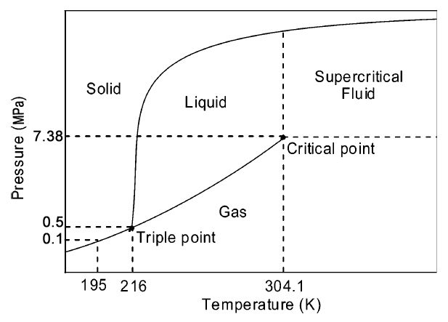
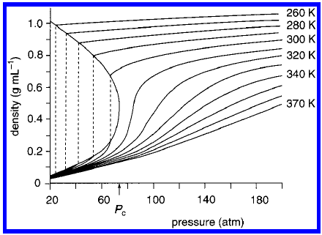
Characteristics of CO₂
Physicochemical properties
(4)
(5)
(4) C.M. Rayner,. Org. Process. Res. Dev. 11 (2007) 121.
(5) P.G. Jessop, T. Ikariya, R. Noyori, Chem Rev. 99 (1999) 475.
Notes:
CO₂ CP= 304.12 K and 7.38 Mpa; density of 0.46 g/mL
Increasing pressure increases the density of the scCO2, reaching a liquid-like density, but a distinct liquid layer is not observed.
We typically work between 35 and 100 °C and at pressures up to 150 bar. Although higher pressures are possible and routinely available, most of the interesting effects we have observed have been in the 100-120 bar region.
The unusual aspects of reactions in supercritical fluids, such as high diffusion rates, low solvent viscosity, and limited solvation of reacting species.
The second main point about scCO2 is its tuneability as a solvent. Varying temperature and pressure allows manipulation of the density of CO2 which determines much of its power as a solvent.
Increasing pressure increases the density of the CO2 for a given temperature, such that at pressures of, for example 120 bar at 40 °C, densities of around 0.7 are typical. Beyond such densities, however, SCFs tend to lose some of their “magic” properties. At high temperatures, density for a given pressure can be lower that expected; for example at 100 °C and 120 bar the density of CO2 is approximately 0.24 g/mL; consequently, much higher pressures are often required at higher temperatures for appreciable solvation of solutes.
Achieving a homogeneous SCF mixture is frequently not necessary, especially in batch processes. What is more important is that phase behaviour is understood which reagents are in or out of solution, and if the reaction is occurring in the scCO2 or as a neat liquid phase at the bottom of the reactor.

Slide 5
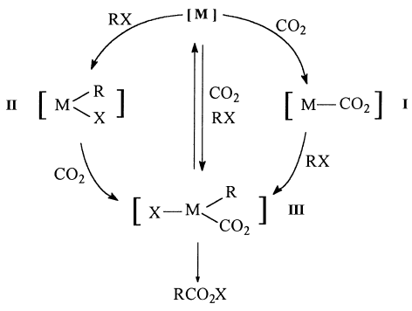
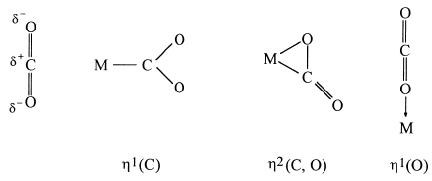
Characteristics of CO₂
Structural
Possible coordination modes on a transition metal center (6)
Non-toxic (TLV ≈ 5,000 ppms)
Non- flammable
Environmental safe
Low critical temperature
Abundant and cheap
Green features of scCO₂ (7)
(6) X. Yin, J. R. Moss. Coord. Chem. Rev. 181 (1999) 27.
(7) E. J. Beckman. J. Supercrit. Fluids. 28 (2004) 121.
Notes:
- Numerous ways for CO2 activation are currently under investigation:
All these methods have one feature in common, which is the activation of CO2 by the coordination of CO2 to a transition-metal centre. This coordination lowers the activation energy required in further reactions involving the CO2 molecule, thus increasing the rates of these reactions, as in most cases this step is the rate-determining step for reactions involving CO2. The coordination of CO2 makes it possible to convert this inert molecule with suitable reactants into useful products. The formation of a transition metal–CO2 complex via direct coordination is one of the most powerful and universal ways to induce the inert CO2 molecule to undergo chemical reactions.
n¹(C) - In the n1(C) bonding mode there is a strong, two-electron stabilizing and charge transfer interaction between a d2z type orbital (which is doubly occupied) and the p* orbital of CO2 (which is empty). (confirmed by X-ray crystal structure determinations)
n²(C, O) - In the n2(C,O) side-on coordination mode the orbital interaction pattern is reversed. The dp orbital interacts in a two-electron stabilizing interaction with the p* orbital of CO2. (confirmed by X-ray crystal structure determinations).
No X-ray crystal structural data of the h1(O) coordination mode in transition metal complexes are currently available.
There are three possible routes (see Scheme 1) for the combination of CO2 and a substrate RX at a transition metal centre to give the product RCO2X:
1. Coordination of CO2 to the metal, providing a metal–CO2 complex [I], followed by reaction of the metal–CO2 complex [I] with the substrate RX to give [III].
Subsequent elimination would provide the product RCO2X and reform the starting complex [M];
2. Simultaneously coordinate both CO2 and the substrate at the metal centre to afford [III], followed by reductive elimination to give the product RCO2X and
to reform the starting complex [M]; and
3. Coordinate the substrate to the metal first, forming the substrate–metal complex [II] which could then react with CO2. Subsequent elimination would provide the desired product RCO2X.
CO2 might prove to be a solvent whose strength would rival or surpass that of alkanes and ketones.
TLV (threshold limit value for airborne concentration at 298 K
The unusual aspects of reactions in supercritical fluids, such as high diffusion rates, low solvent viscosity, and limited solvation of reacting species.

Slide 6
Applications of CO₂ in catalysis
Reagent in catalyzed reactions
Solvent for synthesis of catalysts
Solvent of catalytic reactions

Slide 7
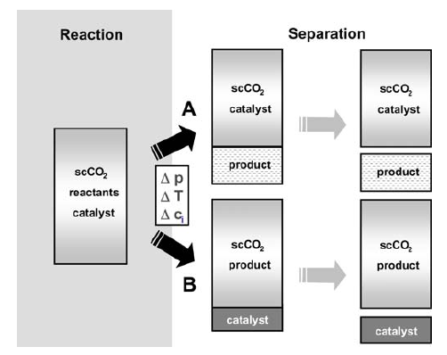
CO₂ as a solvent of catalyzed reactions
Advantages:
Tunable density
Non-polar solvent
May replace organic solvents
(CH₂Cl₂, toluene, methanol, ether, …)
Difficulties:
Weak solvent
Lewis acid
Insolubility of the catalysts
Reaction/separation strategies for multi-phase catalysis in scCO₂ (8)
(8) S. Pitter, E. Dinjus, C. Ionescu, C. Maniut, P. Makarczyk, F. Patcas. Top. Organomet. Chem. 23 (2008) 109.
(9) G. Jessop. J. Supercrit. Fluids. 38 (2006) 211.
Notes:
- Homogeneous catalysis in SCFs has been known since Ipatiev’s experiments in 1913.
In SCF: Mass transfer is very rapid, the solvent is completely miscible with gaseous reactants, and the solvent is easy to be removed from the product. scCO2 is nontoxic, nonflammable, nonhalogenated, nonpolluting [10], and does not cause cancer or other long-term health problems.
One of the benefits of scCO2 for homogeneous catalysis is that rates or selectivities may be significantly higher than in other multi-phase systems or in conventional solvents, because mass transfer across interfaces is enhanced.
- Separation, controllable through changes in pressure and/or temperature and/or composition (with respect to increasing substrate conversion), may take place in two ways, as outlined in the Fig. Both ways, A and B represent elegant approaches to an integrated product/catalyst separation, because the interaction of these control parameters can be adjusted to the requirements for each process.

Slide 8
Solubility of homogeneous catalysts in scCO₂
CO₂ as a solvent
Carbonyl ligands
Highly fluorinated ligands
Trialkylphosphines
Trialkylphosphites
CO₂-philic Ligands
Metal complexes
Typical CO₂-insoluble Ligands
Add CO₂-philic substituents in meta or para positions of aromatic rings
Add co-solvents or surfactants
Switch to more soluble phosphines, as trialkylphosphines
Aromatic
Triphenyl phosphines
Chiral ligands
Alternative
strategies
(13) G. Jessop. J. Supercrit. Fluids. 38 (2006) 211.
Notes:
Homogeneous catalysts are notoriously insoluble in supercritical CO2. The types of ligands that are known to be sufficiently CO2-philic or at least sufficiently nonpolar to be soluble or usable in scCO2 include carbonyl ligands [28–30], highly fluorinated ligands (such as highly fluorinated carboxylates or diketonates) [31,32], trialkylphosphines [15,16,33–35], and trialkylphosphites [36].
Ligands that tend not to make CO2-soluble complexes are aromatic ligands such as the ubiquitous triphenylphosphine and chiral ligands, although strategies to make these soluble have been developed. There are four basic strategies: (a) switch to more soluble phosphines such as trialkylphosphines, despite their greater basicity, (b) switch to the more soluble but not particularly basic tri(2-furyl)phosphine (Scheme 2) [37–40], (c) add cosolvents or surfactants [41–43] to increase the solubility of the complex, and (d) add CO2-philic substituents to the meta or para positions of the aromatic rings. Nonfluorinated substituents which enhance the solubility of triarlyphosphines are extremely rare.

Slide 9
Homogeneous catalysts in scCO₂ could be recovered by……
CO₂ as a solvent
Lowering P to precipitate the catalyst from the SCF (CESS method)
Cooling the SCF until the catalyst precipitates
Using catalysts essentially insoluble in scCO₂ (especially if the reaction is performed in a SCF other than CO₂ but the separation is performed with scCO₂)
Using a membrane allowing the SCF and the products to pass through but not the catalyst.
Releasing entirely the scCO₂ and extracting the fluorinated catalyst from the organic product with a fluorous solvent
Self-separation of a product insoluble in the scCO₂
Dissolution of the catalyst in a liquid immiscible with the SCF (i.e. biphasic catalysis) (water, ionic liquid, a liquid polymer, or ethylene glycol).
Using an inverted biphasic system in which the catalyst preferentially partitions into the scCO₂ while the product preferentially partitions into a liquid immiscible with the scCO₂.
Attaching the catalyst to a solid support (immobilization)

Slide 10
1-Octene hydrogenation
CO₂ as a solvent
Solvent | T (K) | P(H₂) (MPa) | t (h) | Total conv. (%) | TON | TOF | Products (% conv.)
scCO₂ | 353 | 1.0 | 1.5 | 83.8 | 341 | 227 | n-octane (24.6) 2-octene (43.0) 3-octene (16.2)
Toluene | 353 | 1.0 | 5 | 98 | 328 | 66 | n-octane (19.1) 2-octene (56.0) 3-octene (22.9)
Methanol | 353 | 1.0 | 5 | 40.4 | 137 | 27 | n-octane (5.40) 2-octene (23.9) 3-octene (11.1)
P(CO₂) = 10.2 MPa
10. F. Yılmaz, A. Mutlu, H. Ünver, M. Kurtça, I. Kani. J. Supercrit. Fluids. 54 (2010) 202
Notes:
It is known that some organometallic complexes are soluble in dense carbon dioxide to a certain extent, but most metal complexes are less soluble in scCO2 [20]. One solution to this problem is to use fluorinated compounds because organofluorine compounds are highly soluble in scCO2.
Synthesis and characterization of heptadecafluorodecyl-thiophene-2-carbothioate (L1 = SOSRf1, Rf1 = (CH2)2(CF2)7CF3), heptadecafluorononil thiophene-2-carboxylate (L2 =SOORf2, Rf2 =CH2(CF2)7CF3) (perfluoroalkylated-thiophene complexes), and their respective palladium (II) complexes with the formulas of [Pd(L1)X] and [Pd(L2)X] (X = acetate). These complexes were tested as catalysts for the homogeneous hydrogenation of styrene, 1-octene, cyclohexene and cinnamylaldehyde in scCO2. In this paper, and to the best of our knowledge, we report the first examples of olefin hydrogenation catalyzed by Pd(II) complexes containing perfluoroalkylated-thiophene ligands. The hydrogenation of olefins in conventional organic solvents, such as toluene, hexane and methanol, was also studied comparison.
The hemilabile palladium (II) complexes of a perfluoroalkyl substituted thiophene, which contains potentially three donor atoms (SOO or SOS), were demonstrated to be effective catalysts for the homogeneous hydrogenation of styrene and 1-octene, although it showed low activity for cyclohexene in scCO2 and organic solvents.
The catalysis results show that the activity is influenced by the nature of the leaving group such that a better leaving group corresponds to a faster reduction of the substrate. In addition, increases in H2 pressure (up to 1.0 MPa) and the reaction temperature have positive effects on the efficiency of styrene hydrogenation. Finally, scCO2 is a more effective and green reaction medium for homogeneous olefin hydrogenation than conventional organic solvents.

Slide 11
1-Octene hydroformylation
CO₂ as a solvent
L : tris(3,5-bis(trifluoromethyl)phenyl)phosphine
T (K) | P(H₂) (MPa) | t (h) | Selectivity (%) | TOF (mol_{ald} mol_{Rh}⁻¹ h⁻¹)
343 | 39.9 | 1.5 | 98.8 | 7170
(11) A. C. J. Koeken, S. J. M. Bakker, H. M. Costerus, L. J. P. Broeke, B.-J. Deelman, J. T. F. Keurentjes. J. Supercrit. Fluids. 46 (2008) 47.
Notes:
Hydroformylation of alkenes using homogeneous catalysts has been successfully operated commercially for decades. The catalysts are organometallic-complexes of rhodium or cobalt, commonly with phosphines or phosphites as modifying ligands, which are used to convert an alkene, hydrogen, and carbon monoxide into
an aldehyde product.
The use of supercritical fluids in homogeneously metal catalyzed reactions can offer advantages over commonly applied organic solvents including, a high solubility of reactant gases like hydrogen, carbon monoxide and oxygen, the possibility to create a one phase system resulting in the absence of phase boundaries, and “tunability” of solvent characteristics.
Hydroformylation performed in carbon dioxide rich supercritical media has been studied extensively during the past decade [2d] with the hydroformylation of propene among the earliest examples [5a,9].
In this work, the relation between the reaction progress obtained by sampling the reaction mixture and the online measured pressure is investigated for the hydroformylation of 1-octene in scCO2 using an in situ prepared catalyst based on rhodium(I) dicarbonyl acetylacetonate and tris(3,5- bis(trifluoromethyl)phenyl)phosphine.
for the triphenylphosphine-Rh catalyst usually a decrease in activity is observed when the L:Rh ratio is increased. In this case, increasing the ligand to rhodium ratio results in a clear increase of the initial aldehyde formation rate and an increase in regioselectivity in terms of n:iso ratio (plot!!). This demonstrates clearly the advantage of using phosphine-modified catalysts. Increasing the L:Rh ratio from 10:1 to 50:1 gives an increase in aldehyde production rate that is less pronounced. The profiles for L:Rh = 10:1 and L:Rh = 50:1 almost coincide with each other.
The dependence of the reaction rate on the L:Rh ratio observed for the I-Rh catalyst is remarkably different from the results reported in literature on the hydroformylation of linear alkenes with the well-known triphenylphosphine-Rh catalyst system [16,18,19]. In our work, the increase in reaction rate is combined with an enhancement of selectivity. A possible explanation for this phenomenon can be given when a part of the involved equilibria of the different complexes, C1 to C4, are considered as depicted in Fig. 7. It has been observed by Haji and Erkey that in the presence of an equimolar mixture of syngas (CO/H2) C1 dissociates to yield mainly C2, C3, and the dimer [RhCOL2]2 [20]. They did not observe C1 under those conditions. Also at 70 ◦C it can be assumed that some C4 will formed, certainly, because we applied a higher concentration of CO than Haji and Erkey used in their work [20]. The intermediates C2 and C4 can be considered to be the starting species in the so-called dissociative catalytic hydroformylation cycle [21]. The use of I leads to a considerably faster hydroformylation than the use of the rhodium precursor alone. The increase in regioselectivity and reaction rate could then be explained by a shift from a relatively lower concentration of intermediate C2 (and relatively larger concentration of C4) at the lower I concentration to a relatively higher
concentration of C2 at a higher I concentration, while the concentration of C1 (inactive in hydroformylation) remains negligible. In the case of triphenylphosphine (PPh3) a higher concentration of intermediate C2 than intermediate C4 induces a higher selectivity [21]. For [HRh(CO)n(PPh3)4−n] (n = 1, 2) type of catalysts it is known that an excess of triphenylphosphine leads to the formation of [HRhCO(PPh3)3], which is not active in hydroformylation. For I it
is plausible that a higher concentration of C2 also can give rise to a higher reaction rate.
The increase of reaction rate with the L:Rh ratio for the hydroformylation in scCO2 at the conditions applied here is different from the general trend reported in literature in which the reaction rate decreases with increasing L:Rh ratio.

Slide 12
Epoxidation
CO₂ as a solvent
Substrate | Catalyst (mol %) | PhIO (eq) | Yield (%) | % ee
Styrene | 5 | 2 | 66 | 21 (R)
Styrene | 5 | 4 | 100 | 21 (R)
Cis-β-methylstyrene | 5 | 4 | 100 | 47 (R, S)
Cis-β-methylstyrene | 10 | 4 | 60 | 47 (R, S)
P(CO₂) = 250 bar; T = 35 °C.
(12) C. Gao, W. Shin, J. Han, D. Han, M. A. Chari, H. Kim, K.-H. Ahn. Bull. Korean. Chem. Soc. 30 (2009) 541.
Notes:
Since the Salen-Mn(III) catalyzed epoxidation has been recognized as one of the most useful reactions to synthesize chiral epoxides,7-9 which are versatile synthetic intermediates for the syntheses of biologically and pharmaceutically important molecules, with high levels of enantioselectivity, it will be interesting to see the effect of scCO2 to the enantioselectivity of the reaction.
Perfluorinated Salen-Mn(III) complexes and found that Salen-Mn(III) complexes such as 1 and 2, containing the sterically hindered t-butyl group at C3 and C3’ positions that is required to obtain the high degree of enantioselectivity in chiral Salen-Mn(III) complex catalyzed epoxidations of alkenes and the perfluorinated alkyl group at C5 and C5’ positions.
Salen ligand showed a good solubility in CO2 at 40 °C below 100 bar. At 60 °C, a higher CO2 pressure was required to dissolve the ligand. The solubility of Salen-Mn(III) complexes was found to be low compared with that of the Salen ligand. However, both complexes 1 and 2 were soluble in CO2 at 250 bar and 40 °C. Since the enantioselectivity obtained in a catalytic asymmetric reaction is increased, in general, at a low reaction temperature, 35 oC instead of 40 oC
was used as the reaction temperature.
The reaction was not proceed when H2O2 was used as oxidant, even in the presence of additives such as NMO and N-methylimidazole. Overall, the moderate enantioselectivity values were obtained in scCO2, and these values are slightly lower than the result with organic solvent.12,14 However, our attempts made
us to proceed to a clean and green method. Another important feature of this procedure is the stability of a variety of epoxides under these reaction conditions. Epoxides did not react with CO2 and were isolated after completion of the reaction. This procedure not only preserves the simplicity of the reaction but also produces chiral epoxides in good yields with moderate % ee values.
In summary, we demonstrated that the perfluorinated chiral
Salen-Mn(III) complexes were soluble in scCO2 and served as efficient catalysts in the asymmetric epoxidation of olefins with PhIO in scCO2. This result revealed the great potential of supercritical CO2 as a green solvent and was, to our knowledge, the first report regarding the catalytic enantioselective epoxidation of olefins in scCO2.

Slide 13
Examples of catalyzed reactions in scCO₂
CO₂ as a solvent
Reaction | Substrate | Product | Catalyst
Hydroformylation | CH₂ = CH₂ | RCHO | Ru₃(CO)₁₂
Hydrogenation | PhCH=CHCHO | PhCH=CHCH₂OH | RuCl₃/[(C₆F₅)PCH₂]₂
Oxidation |  |  | FeCl(tpfpp)
Hydroxylation |  |  | Mn(salen)Cl
Polymerization | Ethylene | Polyethylene | Pd complexes
Tpfpp = 5,10,15,20- tetrakis(pentafluorophenyl)porphyrin
(13) G. Jessop. J. Supercrit. Fluids. 38 (2006) 211.
Notes:
Of the 154 systems studied in scCO2,fully 42 concern hydrogenation and hydroformylation, two reactions which have been constantly emphasised over this time
period.

Slide 14
Examples of catalyzed reactions in scCO₂
CO₂ as a solvent
Reaction | Substrate | Product | Catalyst
Carbonylation | CH₄ / CO / hν | CH₃CHO | RhCl(PMe₃)₃
Cyclization | RC≡CR |  | PdCl₂ / CuCl₂
Diels-Alder |  |  | AlCl₃
Epoxidation |  |  | Mo(CO)₆
(13) G. Jessop. J. Supercrit. Fluids. 38 (2006) 211.

Slide 15
Important catalyzed reactions still not sufficiently studied in scCO₂
CO₂ as a solvent
Reaction | Substrate | General Reasons
Carbonylation | ROHs or R-X (X= halogen) | Solutions of very toxic species in SCF are included. Use of very specialized facilities is then mandatory. ¡As P rapidly rises vs. T in SCF, exothermic reactions would represent significant risk of explosion!
Carbonylation | R-NO₂ (R = aromatic)
Hydrocyanation | Olefins
Hydrogenation | CO
Hydrogenation | Arenes
Chlorination | Olefins
(13) G. Jessop. J. Supercrit. Fluids. 38 (2006) 211.
Notes:
Since then, one could be forgiven for thinking that almost every kind of reaction imaginable has been studied in at least one SCF (Tables 1–3). However, there are still many important reaction types that have not yet been tested in SCFs: carbonylation of alcohols or alkyl halides [26], carbonylation of nitroarenes to isocyanates, hydrocyanation of olefins, hydrogenation of CO, hydrogenation of arenes [27], chlorination of alkenes, reactions involving very strong bases (e.g. Grignards), and key enantioselective reactions such as isomerization and dihydroxylation. Some of these reactions have been avoided for good reasons. Hydrocyanations and the preparation of isocyanates involve solutions of toxic species in SCFs, a situation that can only be safely handled in very specialized facilities. Because the pressure of SCFs rises rapidly with increasing temperature, exothermic reactions such as the chlorination of alkenes would present a significant explosion risk if performed in SCFs.

Slide 16
Electrocatalysts in scCO₂
CO₂ as a solvent
Wet impregnation
Co-precipitation
Deposition-precipitation
Sol-gel
Microemulsions
Chemical vapor impregnation
Traditional routes for preparation of supported metal nanoparticles
Disadvantage or limitations by poor….
Control on the nanoparticle’s size
Control metal distribution
Metal loading
No easily applied to polymers or aerogels
Alternative
solution
Supercritical Deposition (SCD)
(15) S. E. Bozbag, C. Erkey. J. Supercrit. Fluids. 62 (2012) 1.
Notes:
- Traditional routes for the preparation of supported metal nanoparticles:
Wet impregnation, co-precipitation, deposition–precipitation, sol–gel, microemulsions and chemical vapor impregnation.
- All of these methods have some limitations : Poor control of the nanoparticle size, distribution and metal loading.
- None of these methods can be easily applied to polymers or materials such as aerogels
- SCFs have been used to deposit and incorporate metallic particles into different inorganic and organic substrates for catalytic applications. They have also been investigated in synthesizing carbon supported electrocatalysts for FCs.
-

Slide 17
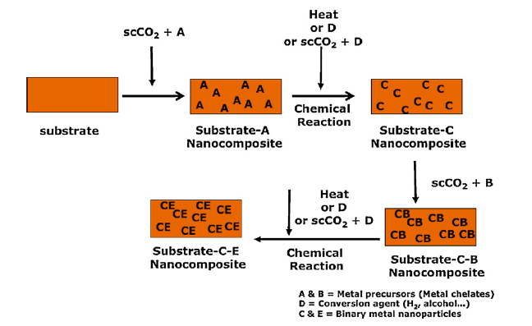
Schematic representation of the sequential supercritical deposition
CO₂ as a solvent
(15) S. E. Bozbag, C. Erkey. J. Supercrit. Fluids. 62 (2012) 1.
Notes:
SCD involves:
Dissolution of a metallic precursor in a SCF.
Exposure of a substrate to the solution.
After incorporation of the precursor with the substrate, the metallic precursor is converted to its metal form by a wide variety of methods resulting in particles or films.
Several precursor conversion techniques have been reported in the literature, including:
(i) chemical decomposition in the SCF with a reducing agent, such as hydrogen and alcohols,
(ii) thermal conversion in the SCF
(iii) thermal decomposition in an inert atmosphere or chemical conversion with hydrogen or air
The process offers controllable nanoparticle size, uniform and narrow size distribution and adjustable metal loading.
Electrocatalysts prepared via SCD can be potentially applied in Fuell Cells.

Slide 18
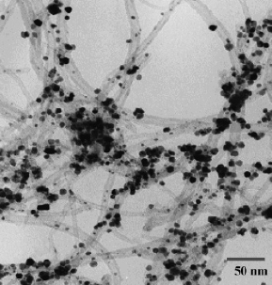
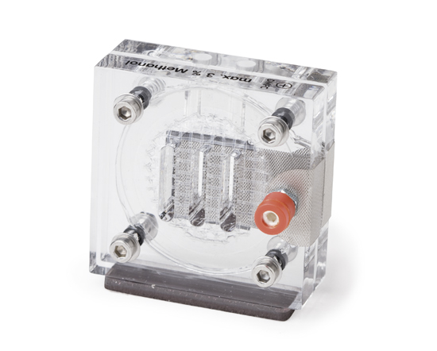
Example of the supercritical deposition
CO₂ as a solvent
8 MPa
16 MPa
0 MPa
CO₂
H₂ / CO₂
Depressurize
CNT
Pt(acac)₂
MeOH
CNT, Pt(acac)₂MeOH
1 hour
15 min
Pt-CNT
473 K
473 K
~293 K
Electrocatalysts for the development of low-temperature
fuel cells.
Application
TEM image of CNT decorated by platinum
nanoparticles synthesized in scCO₂
(25% Pt-CNT, 0.07 mg/cm²)
(16) Y. Lin, X. Cui, C. Yen, C. M. Wai. J. Phys. Chem. B. 109 (2005) 14410.
Notes:
Electrocatalysts prepared via SCD can be potentially applied in Fuell Cells.
Carbon nanotube (CNT)-supported Pt nanoparticle catalysts have been synthesized in supercritical carbon dioxide (scCO2) using platinum(II) acetylacetonate as metal precursor. The structure of the catalysts has been characterized with transmission electron micrograph (TEM) and X-ray photoelectron spectroscopy (XPS).
TEM images show that the platinum particles’ size is in the range of 5-10 nm. XPS analysis indicates the presence of zero-valence platinum. The Pt-CNT exhibited high catalytic activity both for methanol oxidation and oxygen reduction reaction.

Slide 19
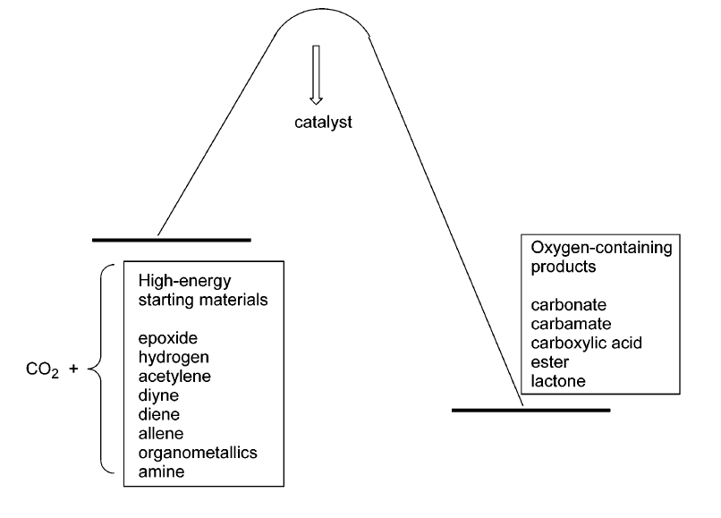
CO₂ as a reagent
Advantages
Cheap raw material
Replace toxic reagents
(Phosgene, carbon monoxide, …)
General drawback
High stability ≈ low reactivity
Oxidized low-energy synthetic targets
high-energy starting materials
Shifting the equilibrium to the product side by removing a particular compound
Supplying physical energy such as light or electricity
(17) T. Sakakura, J. C. Choi, H. Yasuda. Chem. Rev. 107 (2007) 2365.
Notes:
CO2 has been used in the synthesis of urea, cyclic carbonates, salicylic acid and methanol. An increased use of CO2 would only be possible if the relatively inert CO2 molecule could be activated.
CO2 is the most oxidized state of carbon, the biggest obstacle for establishing industrial processes based on CO2 as a raw material is its low energy level. In
other words, a large energy input is required to transform CO2.
There are four main methodologies to transform CO2 into useful chemicals:
To use high-energy starting materials such as hydrogen, unsaturated compounds, small-membered ring compounds, and organometallics.
(ii) To choose oxidized low-energy synthetic targets such as organic carbonates.
(iii) To shift the equilibrium to the product side by removing a particular compound.
(iv) To supply physical energy such as light or electricity. Selecting appropriate reactions can lead to a negative Gibbs free energy of the reaction.

Slide 20
Currently useful processes
CO₂ as a reagent
Fertilizers
Intermediate in the pharmaceutical industry, polymers and cosmetics
Biodegradable polymers
Analgesic and antipyretic
Chemical reagent – H₂ storage
(17) T. Sakakura, J. C. Choi, H. Yasuda. Chem. Rev. 107 (2007) 2365 .

Slide 21
Cycloaddition on epoxides
CO₂ as a reagent
Catalyst | Epoxide | Reaction conditions Solvent P(CO₂) (MPa) T(K) t (h) |  |  |  | Selectivity (%) | Yield (%)
ZnO | PO | DMF | 8.0 | 423 | 15 | 92.6 | 8.7
Mg- Al oxide | PO | TBAB | 0.5 | 393 | 24 | 91.7 | 88.0
Cs-P-Si oxide | PO | ---- | 8.0 | 473 | 8 | 96.0 | 94.0
Cr-salen-SiO₂ | SO | CH₂Cl₂ | 10.0 | 353 | 6 | 100 | 74.0
Mn-salen-SiO₂ | SO | ---- | 3.5 | 413 | 3 | --- | 96
Al-salen-PEA | SO | N-methyl imidazol | 10.0 | 353 | 6 | 87.6 | 78
BMImBF₄/SiO₂ | PO | ---- | 8.0 | 433 | 4 | >99 | 96
Au- ion exchange resin | PO | ---- | 3.0 | 423 | 10 | --- | 89.5
PO = propylene oxide, SO = styrene oxide, TBAB : Tetrabutyl ammonium bromide (co-catalyst),
PEA = poly(ethylene glycol bismethacrylate); BMImBF₄ = 3-n-butyl-1-methyl-imidazolium tetrafluoborate
(18) W. –L. Dai, S.-L. Luo, S.-F. Yin, C.-T. Au. Appl. Catal. A: Gen. 366 (2009) 2.

Slide 22
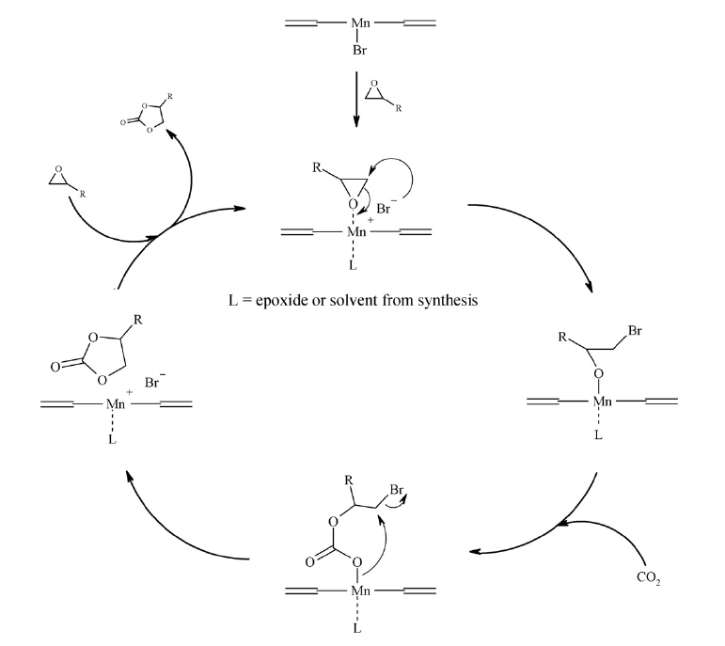
CO₂ as a reagent
Cycloaddition on epoxides
Mechanism of the catalytic cycle for the Mn-(salen)Br complex
(19) F. Jutz, J.-D. Grunwaldt, A. Baiker. J. Mol. Catal. A: Chem. 297 (2009) 63.

Slide 23
Direct synthesis of styrene carbonate catalyzed by [Mn-salenX] complexes
CO₂ as a reagent
Epoxidation
Coupling to CO₂
Direct synthesis of cyclic organic carbonates
* Optimal molar ratio epoxide:CO₂ (1:4) (19)
(19) F. Jutz, J.-D. Grunwaldt, A. Baiker. J. Mol. Catal. A: Chem. 279 (2008) 94.

Slide 24
CO₂ as a reagent
Direct synthesis of styrene carbonate catalyzed by [Mn-salenX] complexes
Complex | Styrene Conversion (%) | Selectivity (%)
 |  | B | PMK | BA | SE | PED | Others
Hydrogen peroxide at 30 wt.%
[Mn(salen)Cl] | 15.0 | 52.1 | 1.8 | 5.3 | 14.5 | 18.9 | 7.4
[Mn(salen)Br] | 3.0 | 73.0 | 2.0 | 3.0 | 2.0 | 0.0 | 20.0
[Mn(salen)I] | 2.5 | 90.0 | 2.8 | 4.0 | 0.0 | 0.0 | 3.2
Iodosylbenzene in CH₂Cl₂
[Mn(salen)Cl] | 9.0 | 66.1 | 4.7 | 0.0 | 16.7 | 0.0 | 12.6
[Mn(salen)Br] | 7.1 | 69.4 | 0.0 | 0.0 | 4.2 | 0.0 | 26.3
[Mn(salen)I] | 5.7 | 71.2 | 0.0 | 0.0 | 2.5 | 0.0 | 26.3
δ⁺
δ⁻
Cl - Br - I
+ Epoxidation -
- Coupling +
B = Benzaldehyde; PMK = Phenyl methyl ketone; BA = Benzoic acid; SE = Styrene epoxide, PED = 1-Phenyl-1,2-ethanediol; and Others = Styrene polymers (dimers and trimers).

Slide 25
CO₂ as a reagent
Direct synthesis of styrene carbonate catalyzed by other systems
Catalyst | Oxidizing agent | P(CO₂) (MPa) | T (K) | t (h) | Yield (%)
TBAB | TBHP | 15 | 273 | 6 | 33
* MTO / Zn[EMIm]₂Br₄/ [BMIm]BF₄ | UHP | 0 – 4 | 303 – 353 | 2 – 2 | 83
Au/R2O1 | TBHP | 0 – 4 | 273 – 423 | 3 – 4 | 51
* Multi-step process; TBAB = tetrabutyl ammonium bromide, TBHP = tert-butyl hydroperoxide;
BMIm = 1-butyl-3-methylimidazolium; EMIm = 1-ethyl-3-methylimidazolium; UHP = Urea hydroperoxide; R2O1 = Amberlite IRA-400 modified
(20) J. Sun, S.-I. Fujita, B. M. Bhanage, M. Arai. Catal. Commun. 5 (2004) 83.
(21) F. Ono, K. Qiao, D. Tomida, C. Yokoyama. Appl. Catal. A: Gen. 333 (2007) 107.
(22) D. Xiang, X. Liu, J. Sun, F.-S. Xiao, J. Sun, Catal. Today. 148 (2009) 383.

Slide 26
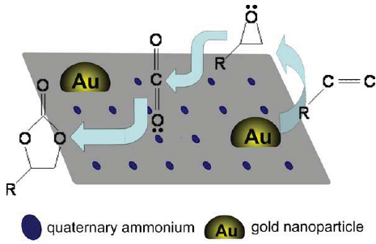
Proposed mechanism for direct synthesis of styrene carbonate catalyzed over Au/R2O1 (22)
CO₂ as a reagent
(22) D. Xiang, X. Liu, J. Sun, F.-S. Xiao, J. Sun, Catal. Today. 148 (2009) 383.

Slide 27
Glycerol valorization
CO₂ as a reagent
Catalyst | T (K) | P(CO₂) (MPa) | Yield (%)
n-Bu₂SnO | 353 | 13.8 | 25
n-Bu₂SnO | 393 | 3.5 | 22
n-Bu₂SnO | 393 | 13.8 | 30
(25) J. George, Y. Patel, M. Pillai, P. Munshi. J. Mol. Catal. A: Chem. 304 (2009) 1.
Notes:
- Glycecol carbonate from glycerol and carbon dioxide
- Catalyst = (dibutyltin(IV)oxide)
The reaction attained equilibrium in 4 h and the yield of 1,2-glycerol carbonate obtained was as high as 35%.
The reaction proceeds upon activation of 1 bymethanol forming dibutyltindimethoxide followed by dibutyltinglycerate, which undergoes CO2 insertion to produce non-isolable 7-membered tin–glycerolcarbonato complex that finally yield glycerol carbonate. Catalyst 1 was found to be successful even with 1,2-propanediol and ethylene glycol yielding the corresponding cyclic carbonates.

Slide 28
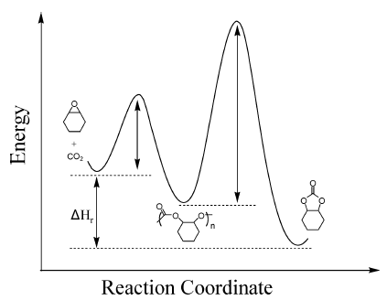
CO₂-copolymerization
CO₂ as a reagent
72.5 Kg·mol⁻¹
P(CO₂) (MPa) / T (K) | t (h) | Yield (%) | TOF | Selectivity (%)
2 / 313 | 0.5 | 14.2 | 290 | 98
2 / 313 | 1.0 | 27.2 | 275 | 99
2 / 313 | 1.5 | 37.5 | 250 | >99
2 / 313 | 2.0 | 46.8 | 234 | >99
(26) H. Li, Y. Niu,. React. Funct. Polym. 71 (2011) 121.
Notes:
- Yields consistently higher against time of reaction, and pretty high selectivities in all the cases.
- Catalysts: (R,R)-SalenCoIIIX [Salen = N,N’-bis(3,5-di-tert-butylsalicylidene)- 1,2-di-phenylethylenediimine; X = OOCCF3 (1), OOCCCl3 (2), and OOCCH3 (3)]
-Alternating copolymerization of carbon dioxide with racemic propylene oxide.
The reaction produces poly(propylene carbonate) and propylene carbonate.
The complex 1/[PPN]Cl catalyst system exhibited high catalytic activity, high PPC/PC selectivity, and produced completely alternating copolymers with as high as 95% head-to-tail linkages. Additionally, a high molecular weight of 72.5 kg mol1 for the copolymer was achieved.

Slide 29
Hydroformylation with CO₂
CO₂ as a reagent
Reaction condition: 4 mmol 1-hexene, 0.2 mmol catalyst, PCO₂ : 2.5 Mpa, PH₂ : 2.5 Mpa, 423 K, 17 hours
Promoter (mmol) | Solvent | Alcohols (%) | Aldehydes (%) | Hexane (%)
LiCl (0.09) | Toluene/NMP | --- | --- | 100
LiCl (0.75) | Toluene/NMP | 55 | 9 | 36
LiCl (0.75) | DMF | 65 | --- | 30
LiCl (0.75) | NMP | 55 | 9 | 36
[BMIM]Cl (0.75) | NMP | 60 | --- | 40
NMP : 1-methyl-2-pyrrolidone, DMF : dimethylformamide, [BMIM]Cl : 1-butyl-3-methylimidazolium chloride
(31) M.-L. Kontkanen, L. Oresmaa, M. A. Moreno, J. Jänis, E. Laurila, M. Haukka. Appl. Catal. A: Gen. 365 (2009) 130 .
Notes:
Hydroformylation of 1-hexene using carbon dioxide as a reactant by a One-dimensional metal atom chain [Ru(CO)4]n as a catalyst.

Slide 30
Concluding remarks
CO₂ capture and storage:
Development of novel and efficient materials is determinant.
CO₂ as a solvent:
Improved immobilization of active metal complexes on solid supports is required.
One of the more interesting applications of scCO₂ is in the preparation of metal nanoparticles by SCD.
CO₂ as a reagent:
A close compromise between active sites may enable more efficient one-pot production of cyclic carbonates from olefines, by using scCO₂ playing a simultaneous role of solvent and reagent.
Notes:
Cyclic carbonate formation reactions with epoxides easily proceed with many kinds of catalysts, such as transition metal compounds
This is because the epoxides are very reactive substrates with carbon dioxide. Cr, Ru, Co, Pd and Au metals or metal compounds are especially effective as industrial catalysts because of their high TON and TOF values.
Formic acid is used in the fields of silage additives and preservatives. Recently, it has attracted interest as a hydrogen storage material because of the excellent synthetic method with a high yield and high TON and TOF values. 5. Methanol is the most important organic chemical in this regard. We expect that methanol can be prepared in a carbon dioxide utilization purpose by utilizing hydrogen produced using natural energies, such as electric power generation with geothermal resources, wind or water

Slide 31
Notes:
Cyclic carbonate formation reactions with epoxides easily proceed with many kinds of catalysts, such as transition metal compounds
This is because the epoxides are very reactive substrates with carbon dioxide. Cr, Ru, Co, Pd and Au metals or metal compounds are especially effective as industrial catalysts because of their high TON and TOF values.
Formic acid is used in the fields of silage additives and preservatives. Recently, it has attracted interest as a hydrogen storage material because of the excellent synthetic method with a high yield and high TON and TOF values. 5. Methanol is the most important organic chemical in this regard. We expect that methanol can be prepared in a carbon dioxide utilization purpose by utilizing hydrogen produced using natural energies, such as electric power generation with geothermal resources, wind or water

