Slide 1
Optimization of Methyl Orange’s Catalytic Wet Peroxide Oxidation (CWPO) by the Response Surface Methodology
Luis Alejandro GALEANO^{1,*}, Viviana N. AGUILAR¹, Miguel A. VICENTE² and Antonio GIL³
¹ Research Group on Functional Materials and Catalysis (GIMFC), Department of Chemistry, University of Nariño. Calle 18 Cra. 50, Campus Torobajo, Pasto – Colombia.
² Department of Inorganic Chemistry, Chemical Sciences Faculty, Salamanca University. Plaza de la Merced, s/n, Salamanca, 37008. Spain.
³ Department of Applied Chemistry, Public University of Navarra. Edificio Los Acebos, Campus de Arrosadía, Pamplona, 31006. Spain.
(*) Corresponding author: alejandrogaleano@udenar.edu.co

Slide 2
INTRODUCTION

Slide 3
Advanced Oxidation Processes (AOPs)
CWPO
Fe,Cu – bearing solid catalysts
H₂O₂/Fe²⁺ (Fenton)
TiO₂/hν/O₂ Photocatalytic
H₂O₂/Fe³⁺ (Fenton - like)
H₂O₂/Fe²⁺ (Fe³⁺) /UV (Photoassisted Fenton)
Mn²⁺/Oxalic acid/O₃
HO·
H₂O₂/Fe³⁺- oxalate
H₂O₂/UV
O₃/UV
O₃/H₂O₂

Slide 4
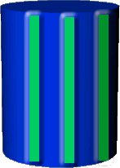
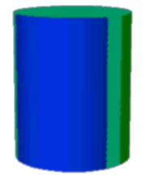
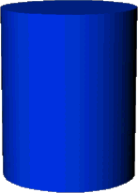
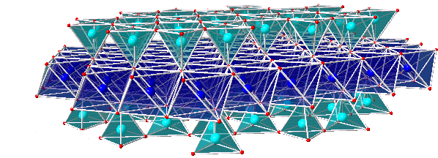
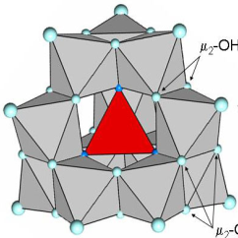
Al Cluster
Fe cluster
Al/Fe mixed pillar
S_{BET}
T stability
Catalytic activity
Al₂O₃ - Pillar
Fe “decorated”
Al₂O₃ - pillar

Slide 5
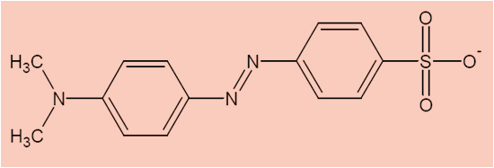
Catalytic Wet Peroxide Oxidation (CWPO) of MO
(MO)
H₂O₂
HO. + HO.₂
CO₂ + NO₃⁻ + SO₄²⁻ + H₂O
Galeano et al. (2010). Appl. Catal. B: Environ. 100, 271-281.

Slide 6
Factors affecting catalytic assessment in CWPO reaction
CWPO
[subst.]
pH
Catal. nature
[Catal.]
[H₂O₂]
T
P
Etc….
[MO]
pH
[Catal.]
[H₂O₂]

Slide 7
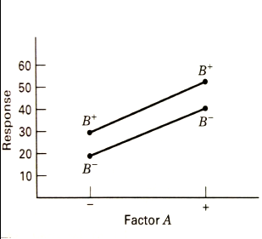
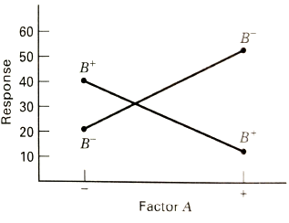
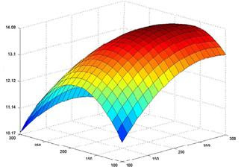
One factor at a time….
DOE/RSM
Statistically significant results
Minimum number of experiments
Montgomery D.C., (2005). Design and Analysis of Experiments, 6^{th.} ed., John Wiley & Sons, Inc.

Slide 8
Materials and methods

Slide 9
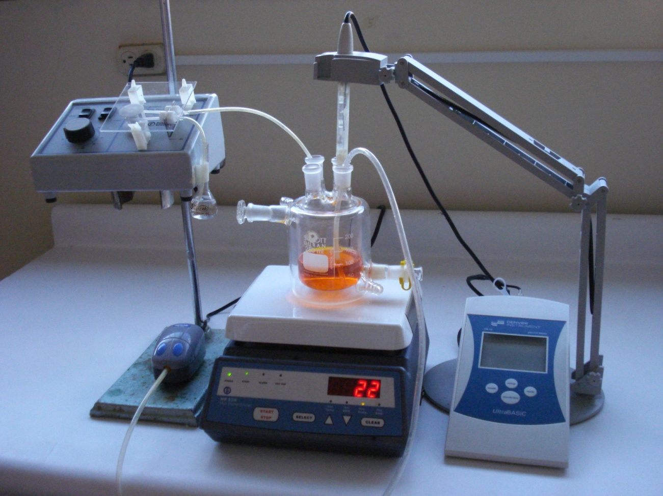
Catalytic test
pH control:
NaOH (sln.) 0.2 M
H₂SO₄ (sln.) 0.2 M
H₂O₂ addition
Air bubbling (CO₂ displacement)
250 cm³ MO (sln)
+ powdered
catalyst
Sampling
(4 h)

Slide 10
Experimental Design – CWPO optimization
Type of design: 2⁴ factorial design
Number of runs: 16
Response parameters: MO elimination
[H₂O₂]_{rem.}
Table 1. Chosen levels for every factor in the experimental design
FACTOR | Low level (-1) | High level (+1)
pH | 3.7 | 7
[H₂O₂] (mol/L) | 0.0685* | 1.0964**
[MO] (mg/L) | 50 | 200
[CAT] (g/L) | 0.5 | 5.0
* It corresponds to 50 % of the theoretical dosage required for full mineralization.
** It corresponds to 200 % of the theoretical dosage required for full mineralization.
Statgraphics ® Centurion XVI professional statistical package was used for analyses.

Slide 11
results

Slide 12
Statistical analysis for response parameter MO elimination (%)
Table 2. Analysis of variance for MO elimination (%)
Source | Sum of Squares |  | FD | Mean Square | F | P-value
A: [CAT] | 178.289 | 1 |  | 178.289 | 7.45 | 0.0413
B: pH | 46.6831 | 1 |  | 46.6831 | 1.95 | 0.2213
C: [MO] | 46.7514 | 1 |  | 46.7514 | 1.95 | 0.2210
D: [H₂O₂] | 1104.07 | 1 |  | 1104.07 | 46.14 | 0.0011
AB | 124.267 | 1 |  | 124.267 | 5.19 | 0.0716
AC | 133.807 | 1 |  | 133.807 | 5.59 | 0.0644
AD | 72.5478 | 1 |  | 72.5478 | 3.03 | 0.1421
BC | 399.3 | 1 |  | 399.3 | 16.69 | 0.0095
BD | 18.5977 | 1 |  | 18.5977 | 0.78 | 0.4183
CD | 15.1516 | 1 |  | 15.1516 | 0.63 | 0.4623
Error total | 119.632 | 5 |  | 23.9264
Total (corr.) | 2259.09 | 15

Slide 13
[H₂O₂]
BC
A: [CAT]
AC
AB
AD
C: [MO]
B: pH
BD
CD
Standardized effect
Figure 1. Pareto’s diagram for MO elimination (%)

Slide 14
(a)
(b)
(c)
(d)
(e)
(f)
Figure 2. Surface diagrams for the response MO elimination (%)

Slide 15
Statistical analysis for response parameter [H₂O₂]_{rem} (%)
Table 3. Analysis of variance for [H₂O₂]_{rem} (%)
Source | Sum of Squares | FD | Mean Square | F | P-value
A:[CAT] | 0,600625 | 1 | 0,600625 | 0,74 | 0,4297
B:pH | 0,25 | 1 | 0,25 | 0,31 | 0,6034
C:[NM] | 1,4641 | 1 | 1,4641 | 1,80 | 0,2377
D:[H₂O₂] | 21,2982 | 1 | 21,2982 | 26,15 | 0,0037
AB | 0,2601 | 1 | 0,2601 | 0,32 | 0,5964
AC | 0,0025 | 1 | 0,0025 | 0,00 | 0,9580
AD | 0,255025 | 1 | 0,255025 | 0,31 | 0,5999
BC | 2,80563 | 1 | 2,80563 | 3,44 | 0,1226
BD | 0,64 | 1 | 0,64 | 0,79 | 0,4160
CD | 1,21 | 1 | 1,21 | 1,49 | 0,2773
Error total | 4,07278 | 5 | 0,814555
Total (corr.) | 32,859 | 15

Slide 16
Figure 3. Pareto’s diagram for [H₂O₂]_{rem} (%)

Slide 17
Figure 4. Surface diagrams for the response [H₂O₂]_{rem} (%)

Slide 18
(a)
(b)
(c)
(d)
(e)
(f)
Figure 5. Surface diagrams for combined desirability function

Slide 19
Table 4. Optimal levels for every factor by simultaneous assessment of both response parameters in the CWPO of MO
Factor | Low | High | Optimal
pH | 3.5 | 7.0 | 3.5
[MO] | 50.0 | 200.0 | 200.0
[CAT] | 0.5 | 5.0 | 5.0
[H₂0₂] | 0.0685 | 1.0064 | 0.0685

Slide 20
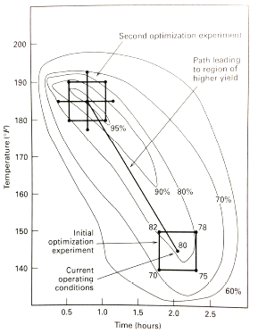
Montgomery D.C., (2005). Design and Analysis of Experiments, 6^{th.} ed., John Wiley & Sons, Inc.

Slide 21
Summary

Slide 22
Multivariate analysis released main factors affecting CWPO elimination of methyl orange.
MO elimination: [H₂O₂] > pH X [MO] > [CAT]
[H₂O₂]_{rem}: [H₂O₂]
Desirability function allowed proper combination of the responses

