Slide 1
Exploring Social, Linguistic and Cultural Diversity in Higher Education: Challenges for English Teachers in Colombia
Jaime Usma
Grupo de Investigación Acción y Evaluación en Lenguas Extranjeras, GIAE
Escuela de Idiomas, Universidad Antioquia de Colombia
53rd ASOCOPI ANNUAL CONGRESS
“Exploring Social and Cultural Diversities in ELT”
October 11th – 13th, 2018,Universidad Tecnológica de Bolívar – Cartagena

Slide 2
This Presentation
Goals:
To raise awareness about cultural, social and linguistic diversity in higher education
To explore alternatives that can be incorporated in ELT in Colombia

Slide 3
This presentation
Current language policies in Colombia
The power of English in higher education
A sociolinguistic diagnosis at UdeA
A pilot study with Afro and Indigenous students
Challenges for English language teachers

Slide 4
A little bit of context
Population: 49.950.000 inhabittants
76% urban, 24% rural
11% Afrocolombian, 3% Indigenous
65 Indigenous Languages, 2 Creole, Rom, Sign language
8.6 millions in Preschool - 11 (85% Public Schools)
2.1 millions in Higher Ed. (61% Undergraduate)

Slide 5
And do not forget
War in Colombia and the Peace Process with FARC:
220 000 killings between 1958 and 2012, 80% unarmed population
8.6 victims up to January 2018
7.2 internal displaced
Huge impact on afro, indigenous, and campesinos
Jesus Abad Colorado https://www.bbc.com/mundo/noticias-america-latina-37452970

Slide 7
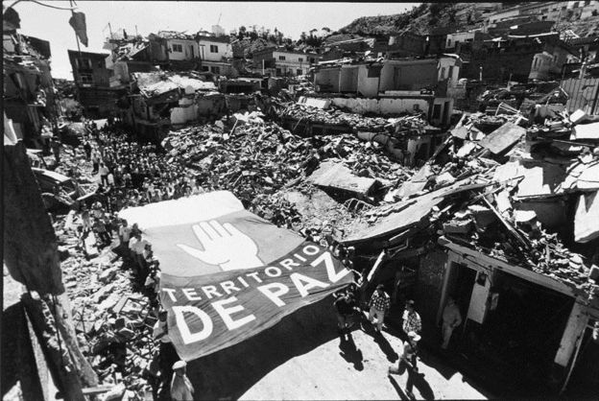

Slide 8
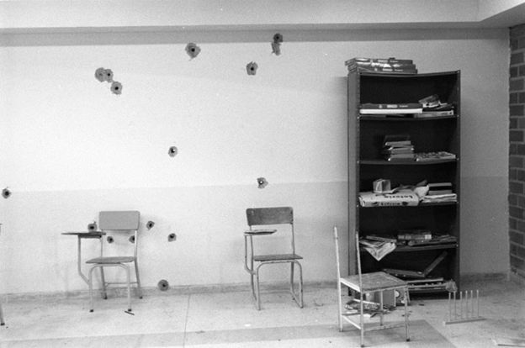

Slide 9
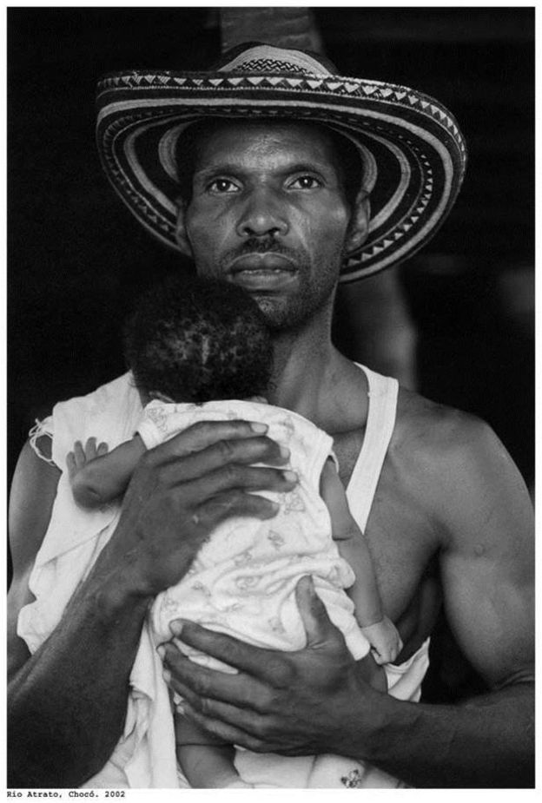

Slide 10
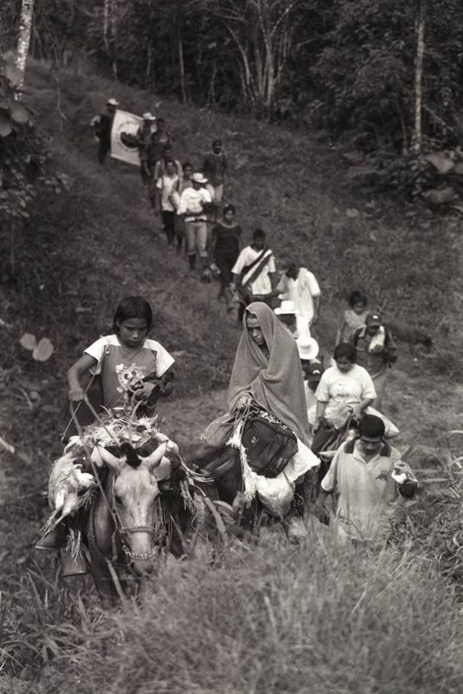

Slide 11
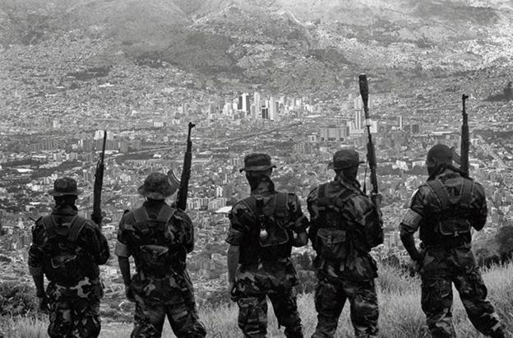

Slide 12
And additionally…
Underfunding of Public Higher Education
#S.O.S. Universidad_Pública

Slide 13
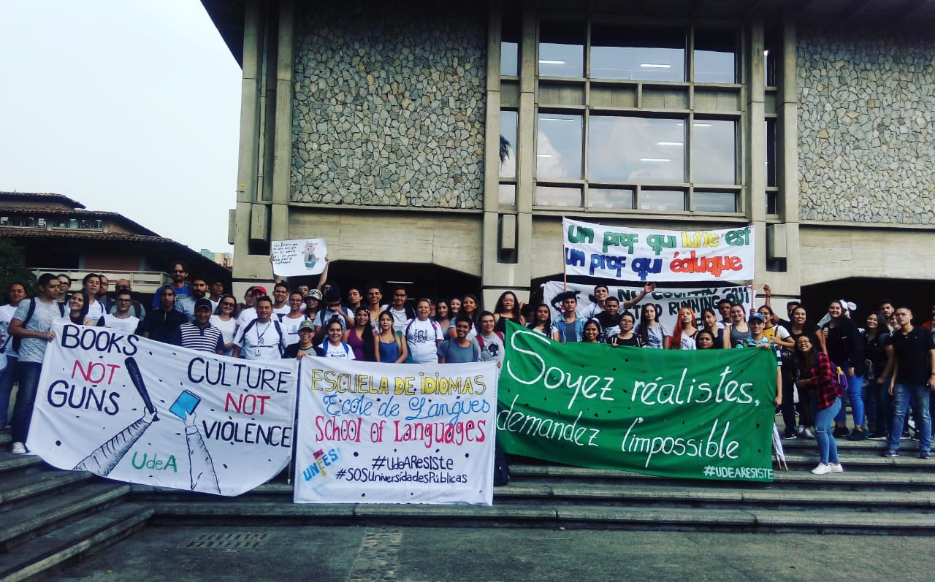

Slide 14
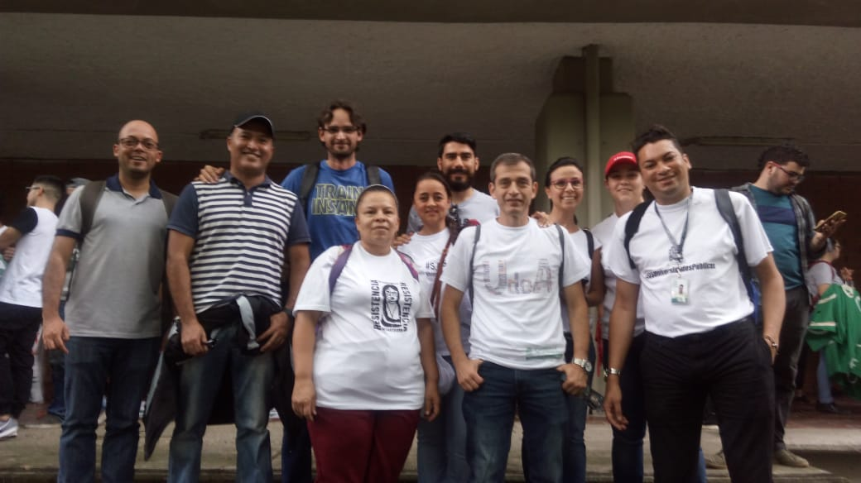

Slide 15
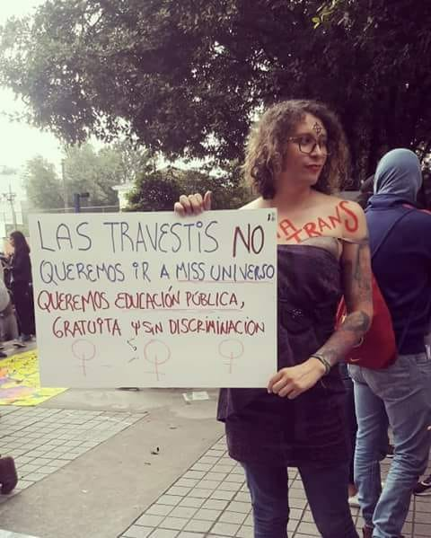

Slide 18
Current Foreign Language Policies in Colombia
2006: Programa Nacional de Bilingüismo (2004-2019)
2010: Programa de Fortalecimiento de Competencias en Lengua Extranjera (2010-2014)
2014: Programa Nacional de Inglés (2015-2025)
2014: Colombia Bilingüe (2014-2018)

Slide 19
Current Foreign Language Policies in Colombia
Goal:
Lograr que los estudiantes se comuniquen cada vez mejor en inglés y puedan acceder a mejores oportunidades laborales y profesionales

Slide 20
Main policy interventions
British Council and UK Publishing and Testing Companies
CEFR and Standards
Testing and certification
Emphasis on EFL
Textbooks
National Suggested Curriculum
English teaching international fellows
Emphasis on English in Higher Ed.

Slide 21
FLE Policies in Higher Education
Acuerdo 2034, CESU, 4.8.2. Principales problemas nodales:
8. El bajo nivel de manejo del inglés, lo que limita en gran medida la ejecución de diversas estrategias y acciones que pueden contribuir con la internacionalización de la educación superior: movilidad estudiantil, docente, administrativa; trabajo en redes; investigaciones conjuntas; dobles titulaciones, entre otros. (p.118)
Visión 2034, 5.8. Internacionalización
96. Fortalecer a Colombia como país multilingüe, lo que implica implementar la estrategia nacional de enseñanza del inglés, promover estrategias para la adecuada formación de los profesores y del personal administrativo en el manejo de una segunda lengua; ofertar asignaturas en una segunda lengua en programas académicos de cualquier modalidad; exigir un nivel B1 del sistema del Marco Común Europeo de Referencia para las Lenguas (MCERL) como requisito de grado en el pregrado y el postgrado; y fortalecer los centros de idiomas, incentivando a su vez el uso de las nuevas tecnologías homologadas internacionalmente.

Slide 22
Teacher education Reform and foreing language learning
Decreto 2450, 2015 and Resolución 18583, 2017
C1 for foreign language teachers
B1 for teachers in all areas

Slide 26
The power of English in higher education: Foreign Language Policies at Universidad de Antioquia
Five levels of English
Mandatory for all, including indigenous students

Slide 27
A sociolinguistic diagnosis at UdeA

Slide 28
Some key Concepts
A critical, decolonial and sociocultural approach to language and language education policymaking (Castro-Gómez & Grosfoguel, 2007; Ferrao, 2010; Forastero, 2007; Granados-Beltrán, 2016; Jaraba & Arrieta, 2012; Popkewitz, 1999; Quijano, 1992; Velez–Rendon, 2003; Walsh, 2009).
Trying to move beyond conventional cognitive, linguistic and functional approaches to language, education, teaching, learning, and living in general
Exploring Critical Interculturality in English Language Teaching
Teachers acting as policymakers

Slide 29
Main findings
Huge ethnic and linguistic diversity
876 indigenous students
18 Pueblos, 22 languages
84% speak Spanish as their first language
25 departments out of 32

Slide 30
Challenges faced by indigenous students

Slide 31
Indigenous students hiding their identity
(…) where I studied in high school, I used to be made fun of because of my eyes, my hair, my skin color, even considering they [other students] were darker and even uglier than me [laughs]. . . . And with all that, being a child, if that happens to you as a child, you start to fear and you avoid stuff; you try not to be bothered, pointed at, so you feel embarrassed for that, because for being indigenous, people point at you, discriminate against you (Conversation circle, 2017)

Slide 33
Students having difficulties with academic literacies
Difficulties to use Spanish for academic purposes
Math literacies (challenge for indigenous students in areas like engineering)
For some digital literacy skills also pose a challenge (e-mailing, using university platforms, etc).

Slide 34
Students’ views of English and the new language policy

Slide 35
Students’ positive views of English and the new language policy
Positive views about learning English and about the new foreign language policy (79%)
Learning English is…
important, since it is a global language.
important for our professional development, since it is an essential requirement by all kinds of companies and for people who want to travel abroad.
important for becoming more competitive at a professional level.
(Indigenous students, survey, 2017)

Slide 36
Students negative views of English and the new language policy
18% of surveyed students had a negative view of learning English
62% of surveyed students had experienced difficulties to learn English in secondary school
Learning English is...
Important because English is widely used today, but frustrating because when you do not understand, you feel like the stupidest person.
Hard because it has not been easy for me to understand English
Difficult because English teaching in secondary school was rather bad
(Indigenous student, survey, 2017)

Slide 37
Students’ resistance to learn English and towards the new language policy
3% of participants, that is 10 students in the study, manifested a resistance towards English
Learning English is…
losing my indigenous language and traditions because I would be becoming Western and that would change my way of thinking as an indigenous person. To us, our language is everything, and it is part of our daily life; it is not a pastime activity.

Slide 38
a challenge because I do not like it. My own language is more important to me.
unnecessary because I have a lot to learn about the native languages of my country. We have to give meaning to what is ours, not to what is imposed on us.
an imposition and the extinction of the native languages of our indigenous people because learning English is mandatory in academia.
(Indigenous students, survey, 2017)

Slide 39
A pilot Project at Universidad de Antioquia
Indigenous and Afro students
English language teachers
Implementation of several strategies
Weekly workshop on English and Spanish for academic purposes
Tutoring students
Weekly meetings with teachers: What does it mean to teach English from a critical intercultural perspective?
Re-Reading the city from an afro and indigenous perspective
Creating a family for new coming students
Recognizing and valuing students funds of knowledge and experiences
Highlighting diversity and resistance
Exploring alternatives in English language teaching
Incorporating critical decolonial approaches to English language teaching in Colombia

Slide 41
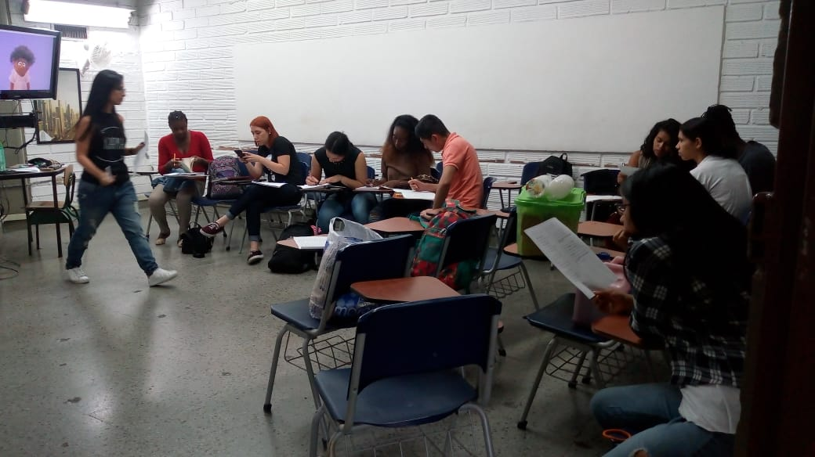

Slide 44
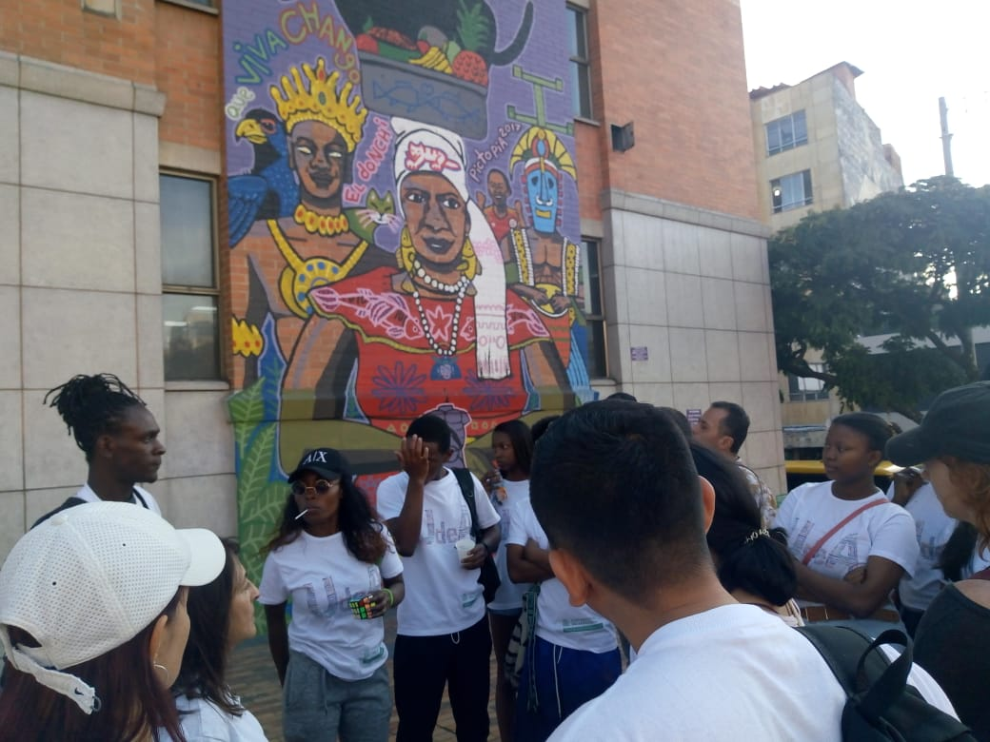

Slide 45
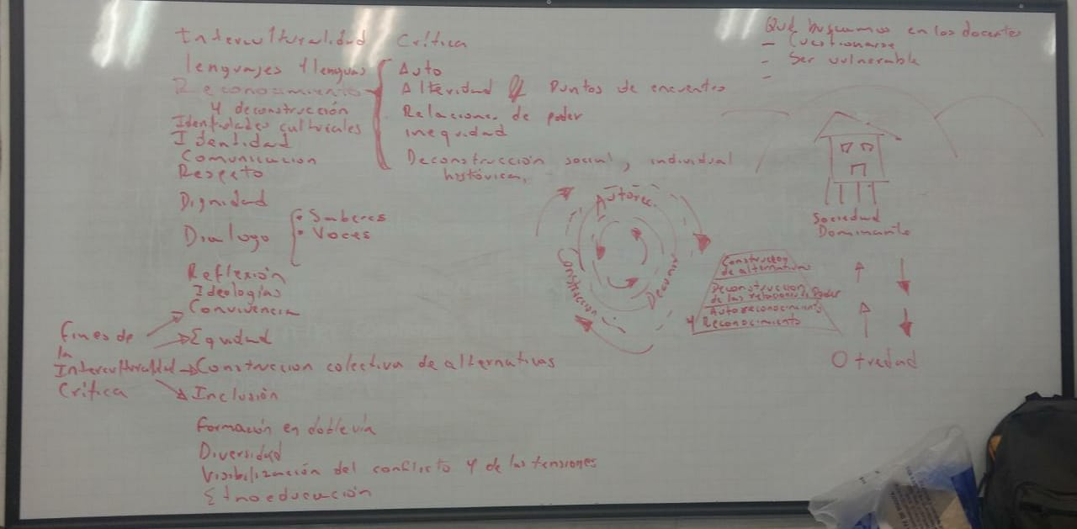

Slide 46
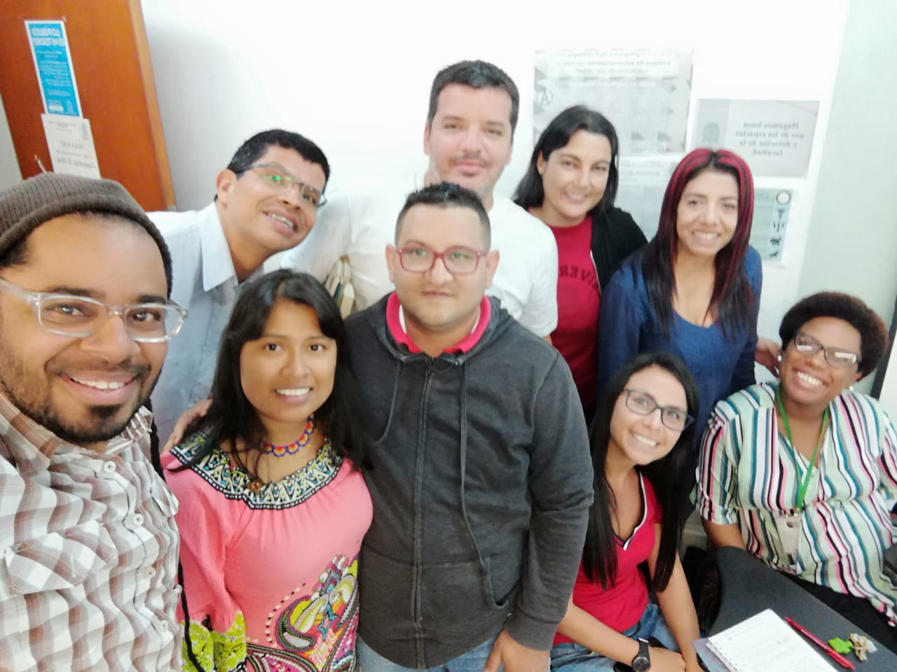

Slide 47
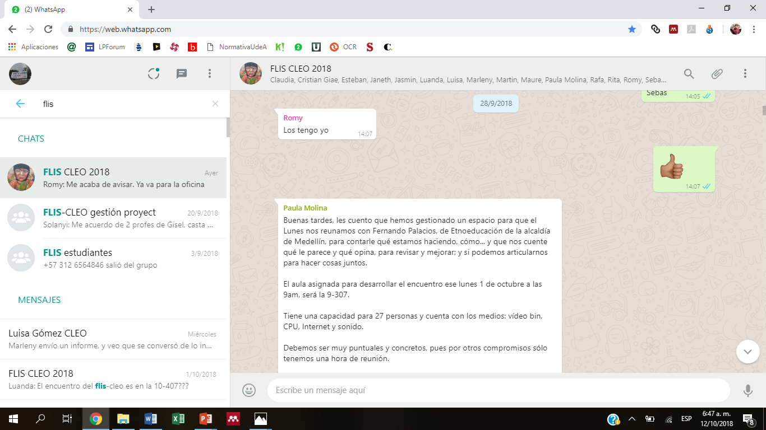

Slide 48
Towards a decolonization of foreign language policy, teaching, and learning in colombia
Internationalizing higher education in dialogue with linguistic, cultural and epistemic diversity in local contexts
Language policies that aim at the promotion, revitalization, and inclusion of local languages and knowledges
Revising principles, approaches, and methods in ELT
Incorporating critical intercultural perspectives in language teaching
Strengthening students’ individual and social identities

Slide 49
Towards a decolonization of foreign language policy, teaching, and learning in colombia
Valuing and incorporating multiple ways of being, understanding, acting, and making meaning
Finding spaces for a real conversation among different groups and cosmogonies in academic spaces
Exploring other perspectives of languages in higher education, beyond instrumental and hegemonic views of English
Recognizing students’ previous background and learning experiences and take actions based on this understanding
Teaching with love
Promoting language diversity beyond English only policies

Slide 50
General challenges
To keep the conversation and activism for a continuous respect and strengthening of local and foreign languages in Colombia
To recognize ethnic and linguistic diversity in the country
To interrupt discourses, structures and practices that make English into a commodity that only a few can afford in Colombia
To critically appropriate language education policies in Colombia
To improve English language teaching and learning in Colombia

Slide 51
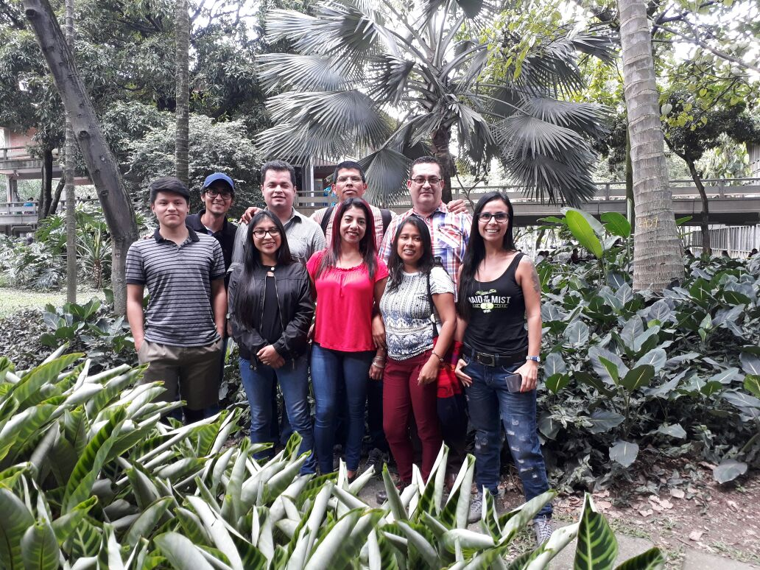
F+gora
Gracias!
Thank you!
Jaime Usma; jaime.usma@udea.edu.co

